Slide 1


Attentional Amplification in Losses: an aDDM Puzzle
Brenden Eum
Stephen Gonzalez
Antonio Rangel

Slide 2





Slide 3
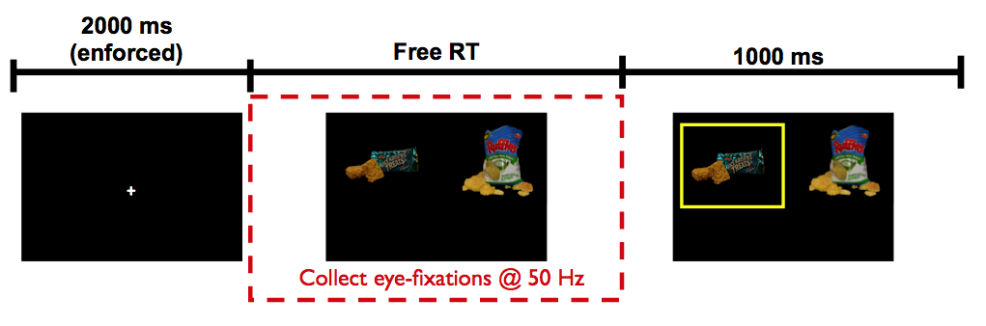
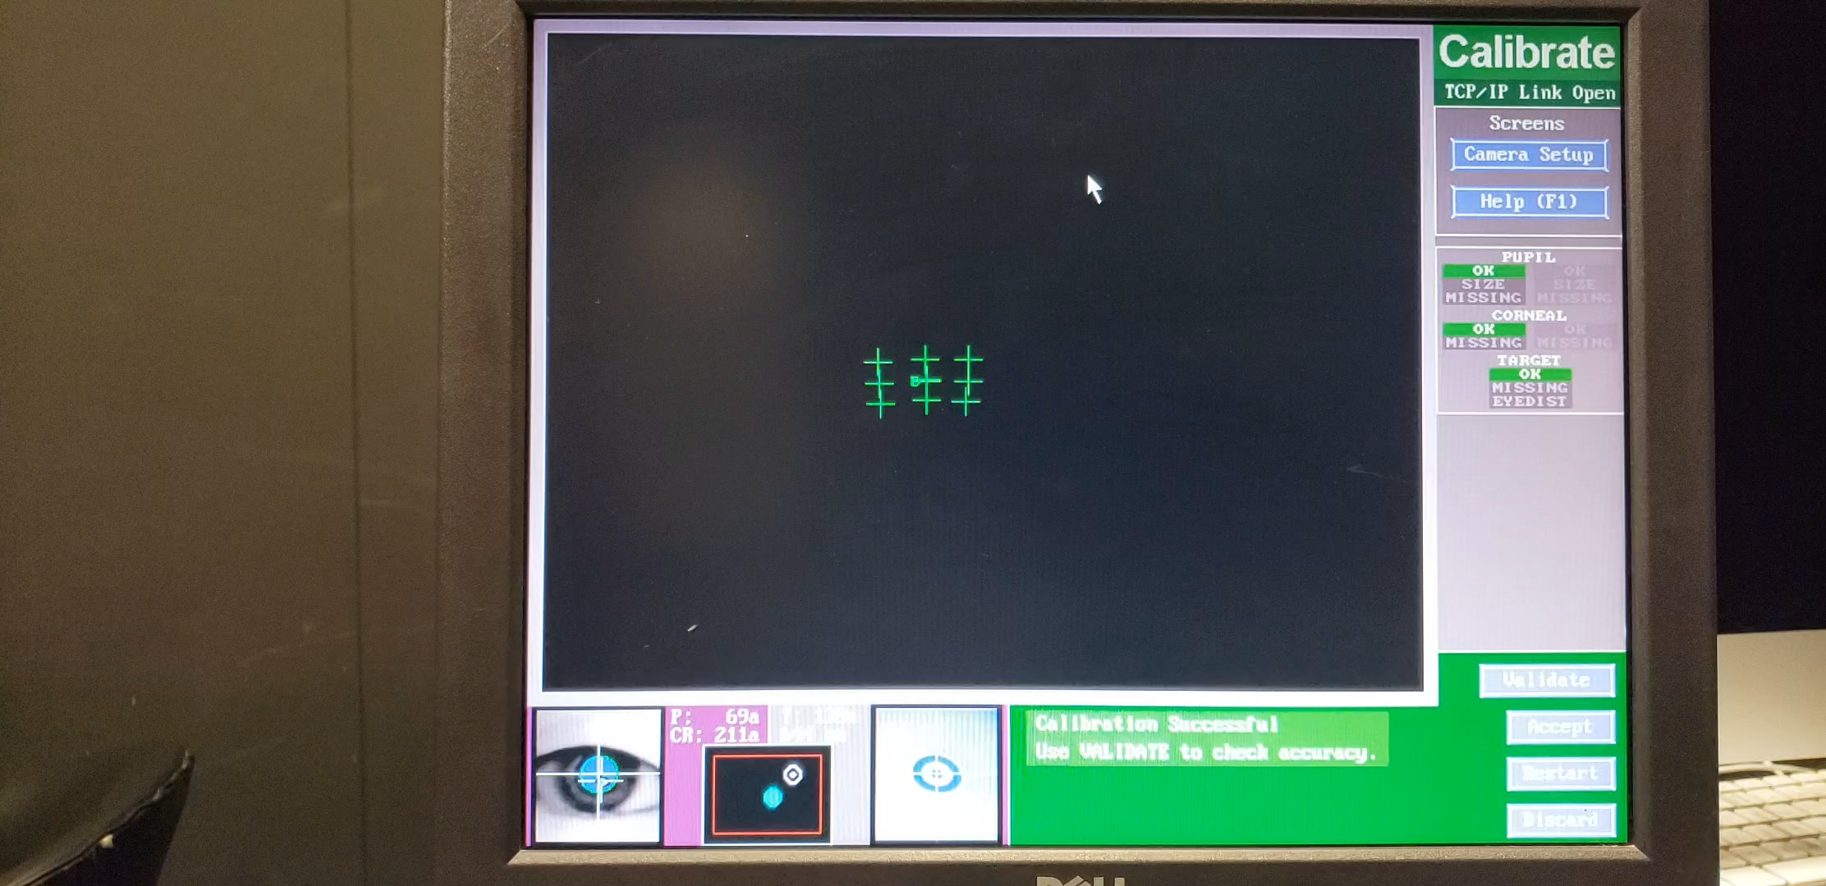
Krajbich, Armel, Rangel (2010, Nat Neuro)

Slide 4
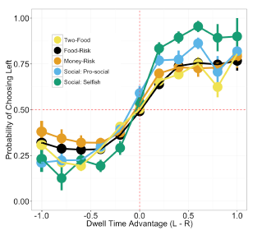
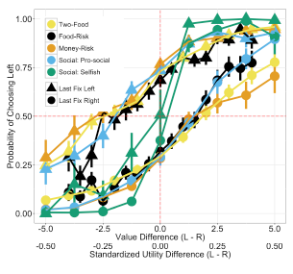
Net Fixation Bias
Last Fixation Bias
Smith, Krajbich (2018, J Exp Psychol Gen)
Notes:
multiple domains

Slide 5
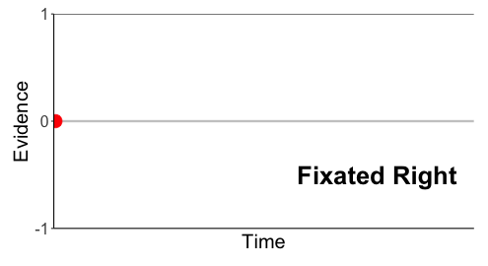
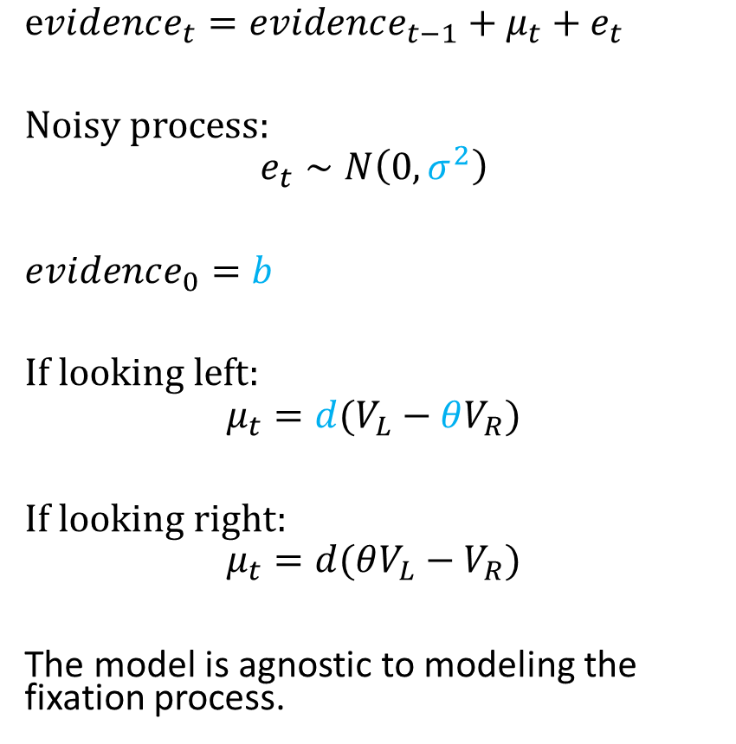
Attentional Drift-Diffusion-Model (aDDM)
$evidence_{t}=evidence_{t−1}+μ_{t}+e_{t}$
Noisy process:
$$e_{t}∼N\left(0, σ^{2}\right)$$
$evidence_{0}=b$
If looking left:
$$μ_{t}=d(V_{L}−θV_{R})$$
If looking right:
$$μ_{t}=d(θV_{L}−V_{R})$$
The model is agnostic to modeling the fixation process.
Pick Left
Pick Right
Notes:
noisy
bias
drift: ddm in value based decisions: evidence accumulated is value comparison
drift
sim
explain fixation sampling process

Slide 6
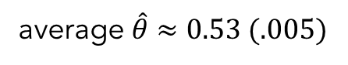
aDDM Predictions
average $\hat{θ}≈0.53 (.005)$
1. Attentional Discounting
2. Net Fixation Bias
3. Last Fixation Bias
Bhatnagar, Orquin (2022, J Exp Psychol Gen)
Smith, Krajbich (2018, J Exp Psychol Gen)

Slide 7
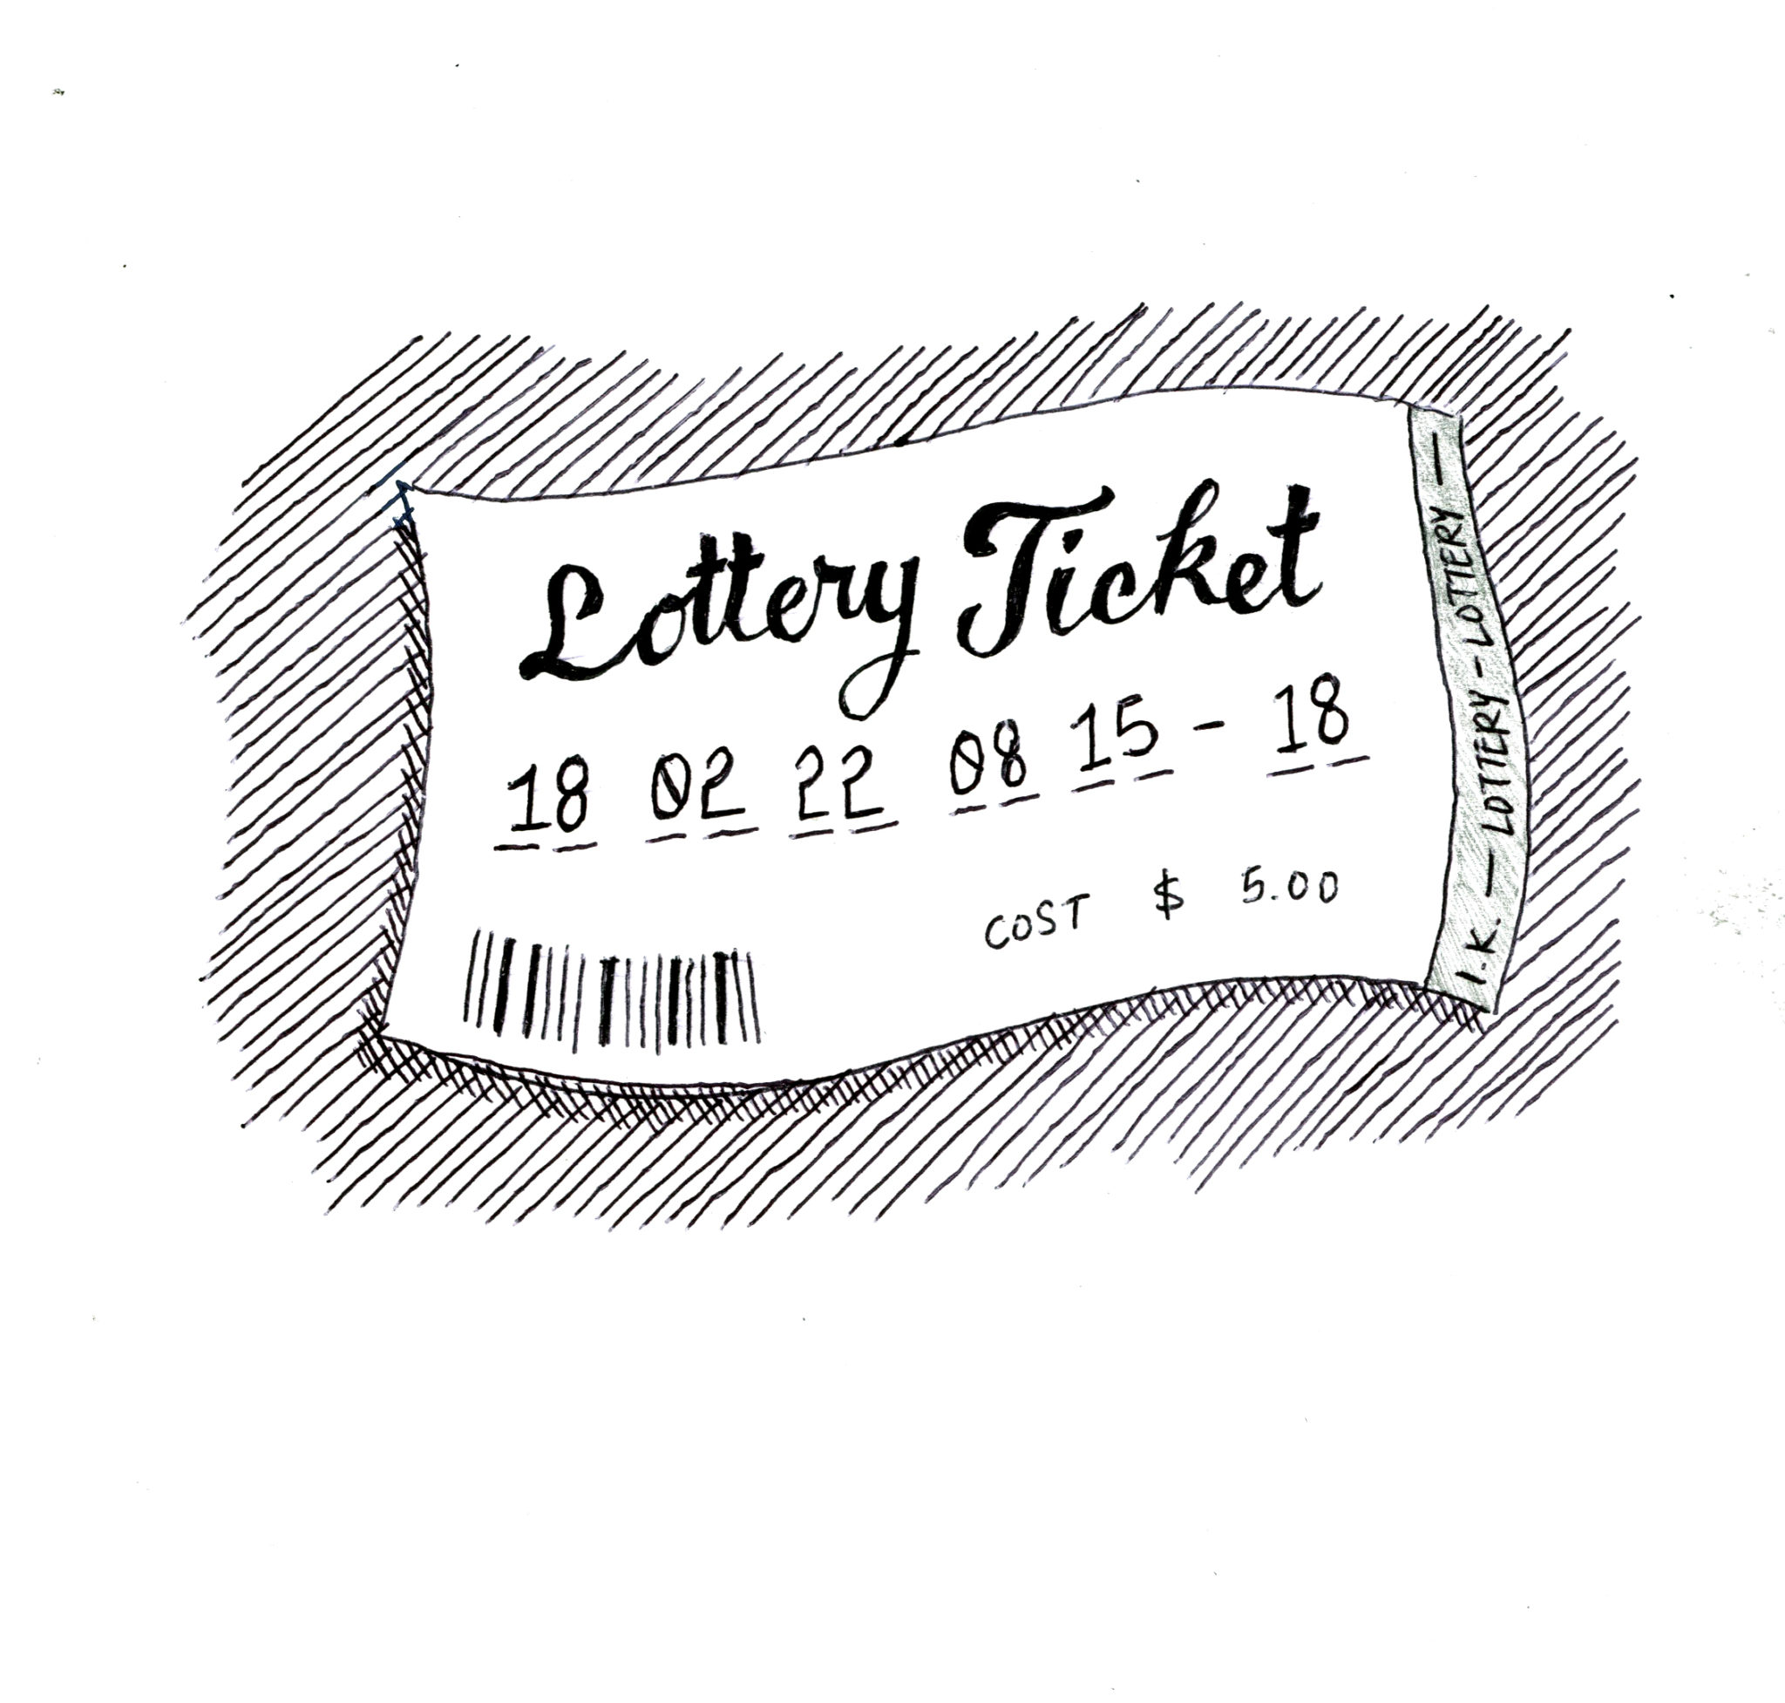
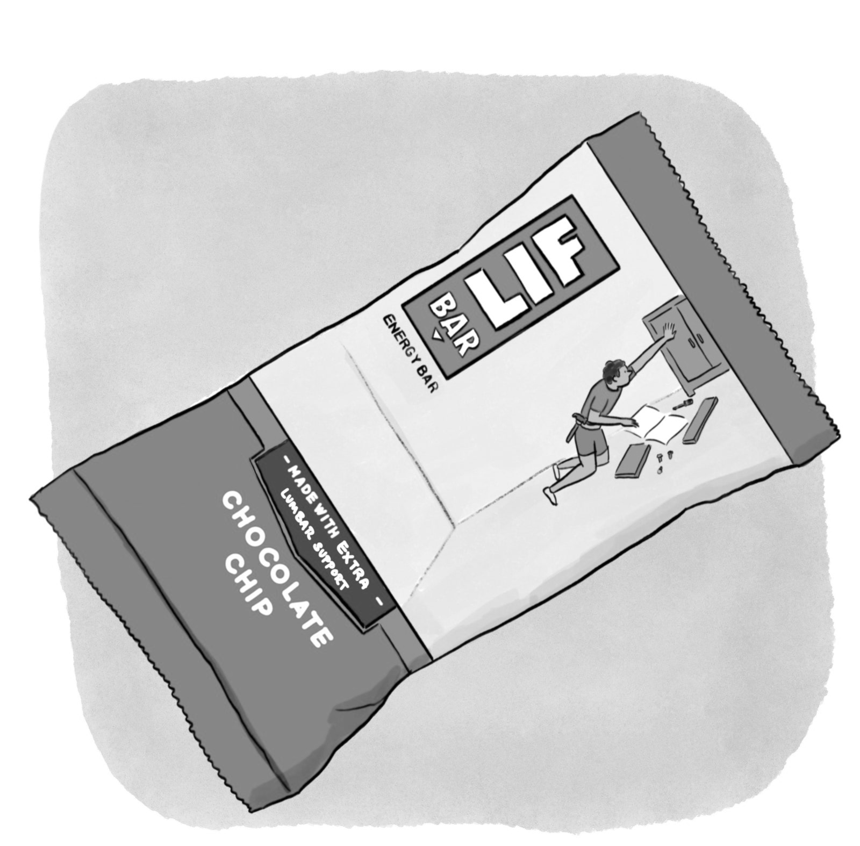
See Smith, Krajbich (2018, J Exp Psychol Gen); Bhatnagar, Orquin (2022, J Exp Psychol Gen); Fiedler, Glöckner (2012, Front Psychol)
Brenden Eum

Slide 8

Brenden Eum

Slide 9
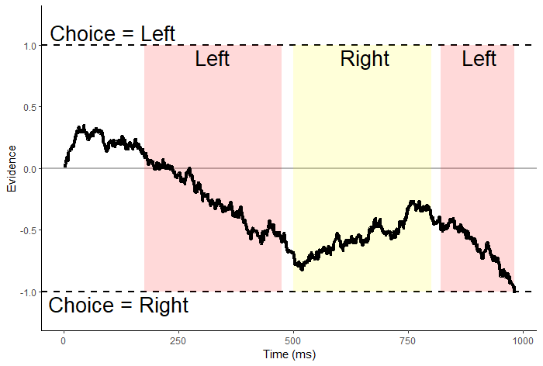
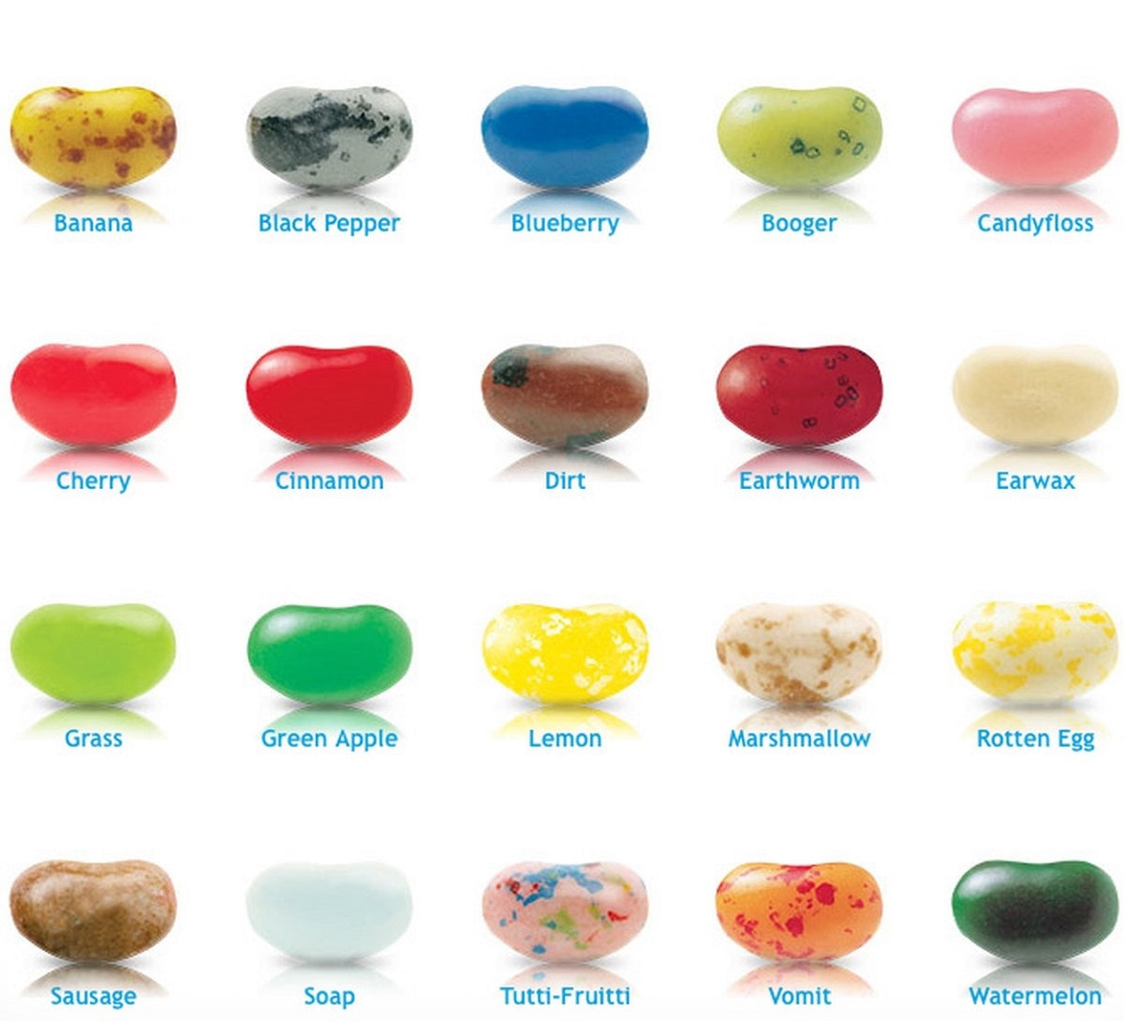
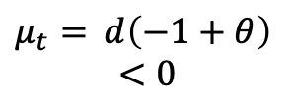
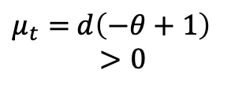
Suppose $V_{L}=−1, V_{R}=−1,$ and $θ∈(0,1)$.
$evidence_{t}=evidence_{t−1}+μ_{t}+e_{t}$
$μ_{t}=$ $d\left(−1+θ\right)$
$<0$
$μ_{t}=$ $d\left(−θ+1\right)$
$>0$

Slide 10
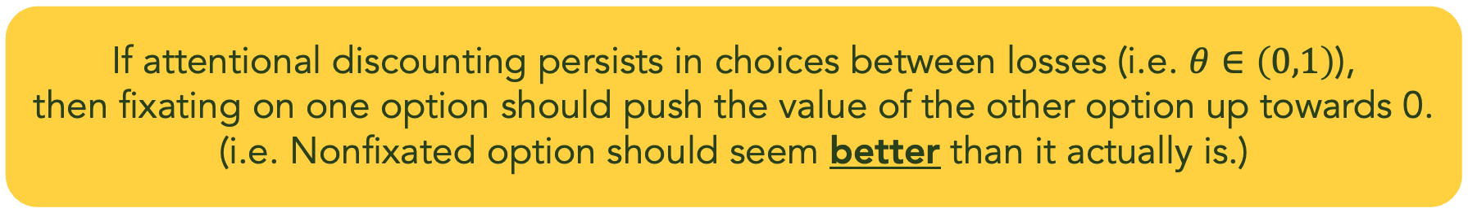
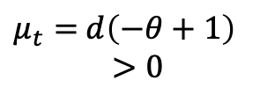
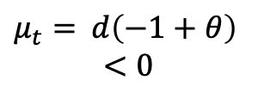
Suppose $V_{L}=−1, V_{R}=−1,$ and $θ∈(0,1)$.
$evidence_{t}=evidence_{t−1}+μ_{t}+e_{t}$
$μ_{t}=$ $d\left(−1+θ\right)$
$<0$
$μ_{t}=$ $d\left(−θ+1\right)$
$>0$
If attentional discounting persists in choices between losses (i.e. $θ∈\left(0,1\right)$),
then fixating on one option should push the value of the other option up towards 0.
(i.e. Nonfixated option should seem better than it actually is.)

Slide 11
Attentional Choice Biases
Net Fixation Bias
Last Fixation Bias
Last fix. right
Last fix. left
P(Left Chosen)
P(Left Chosen)
Final Time Advantage Left (ms)
Left Rating - Right Rating

Slide 12
Attentional Choice Biases
Should Flip!
Net Fixation Bias
Last Fixation Bias
Last fix. right
Last fix. left
P(left chosen)
P(Left Chosen)
Final Time Advantage Left (ms)
Left Rating - Right Rating

Slide 13

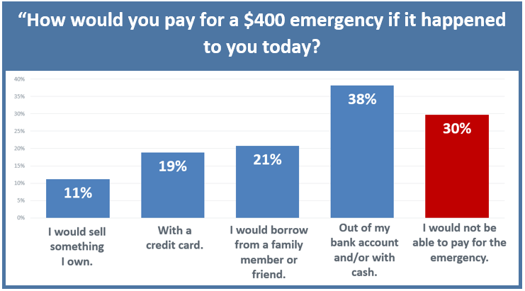
The Center for Community Solutions, Cleveland, Ohio
Brenden Eum

Slide 14
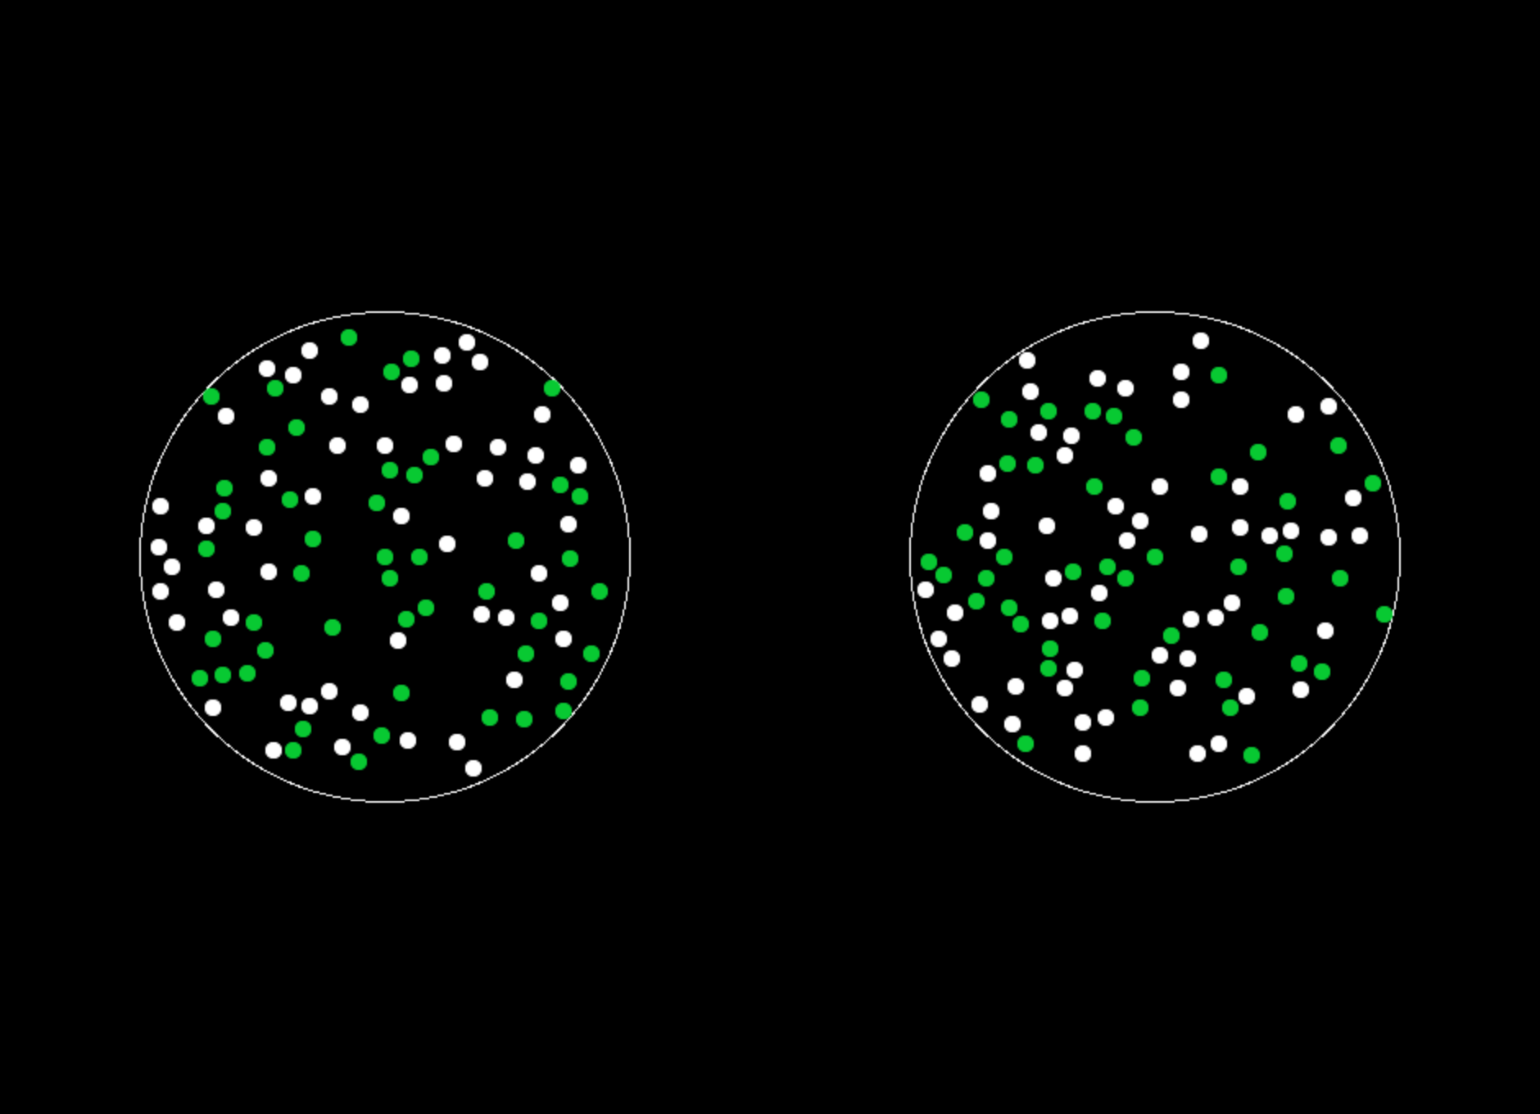
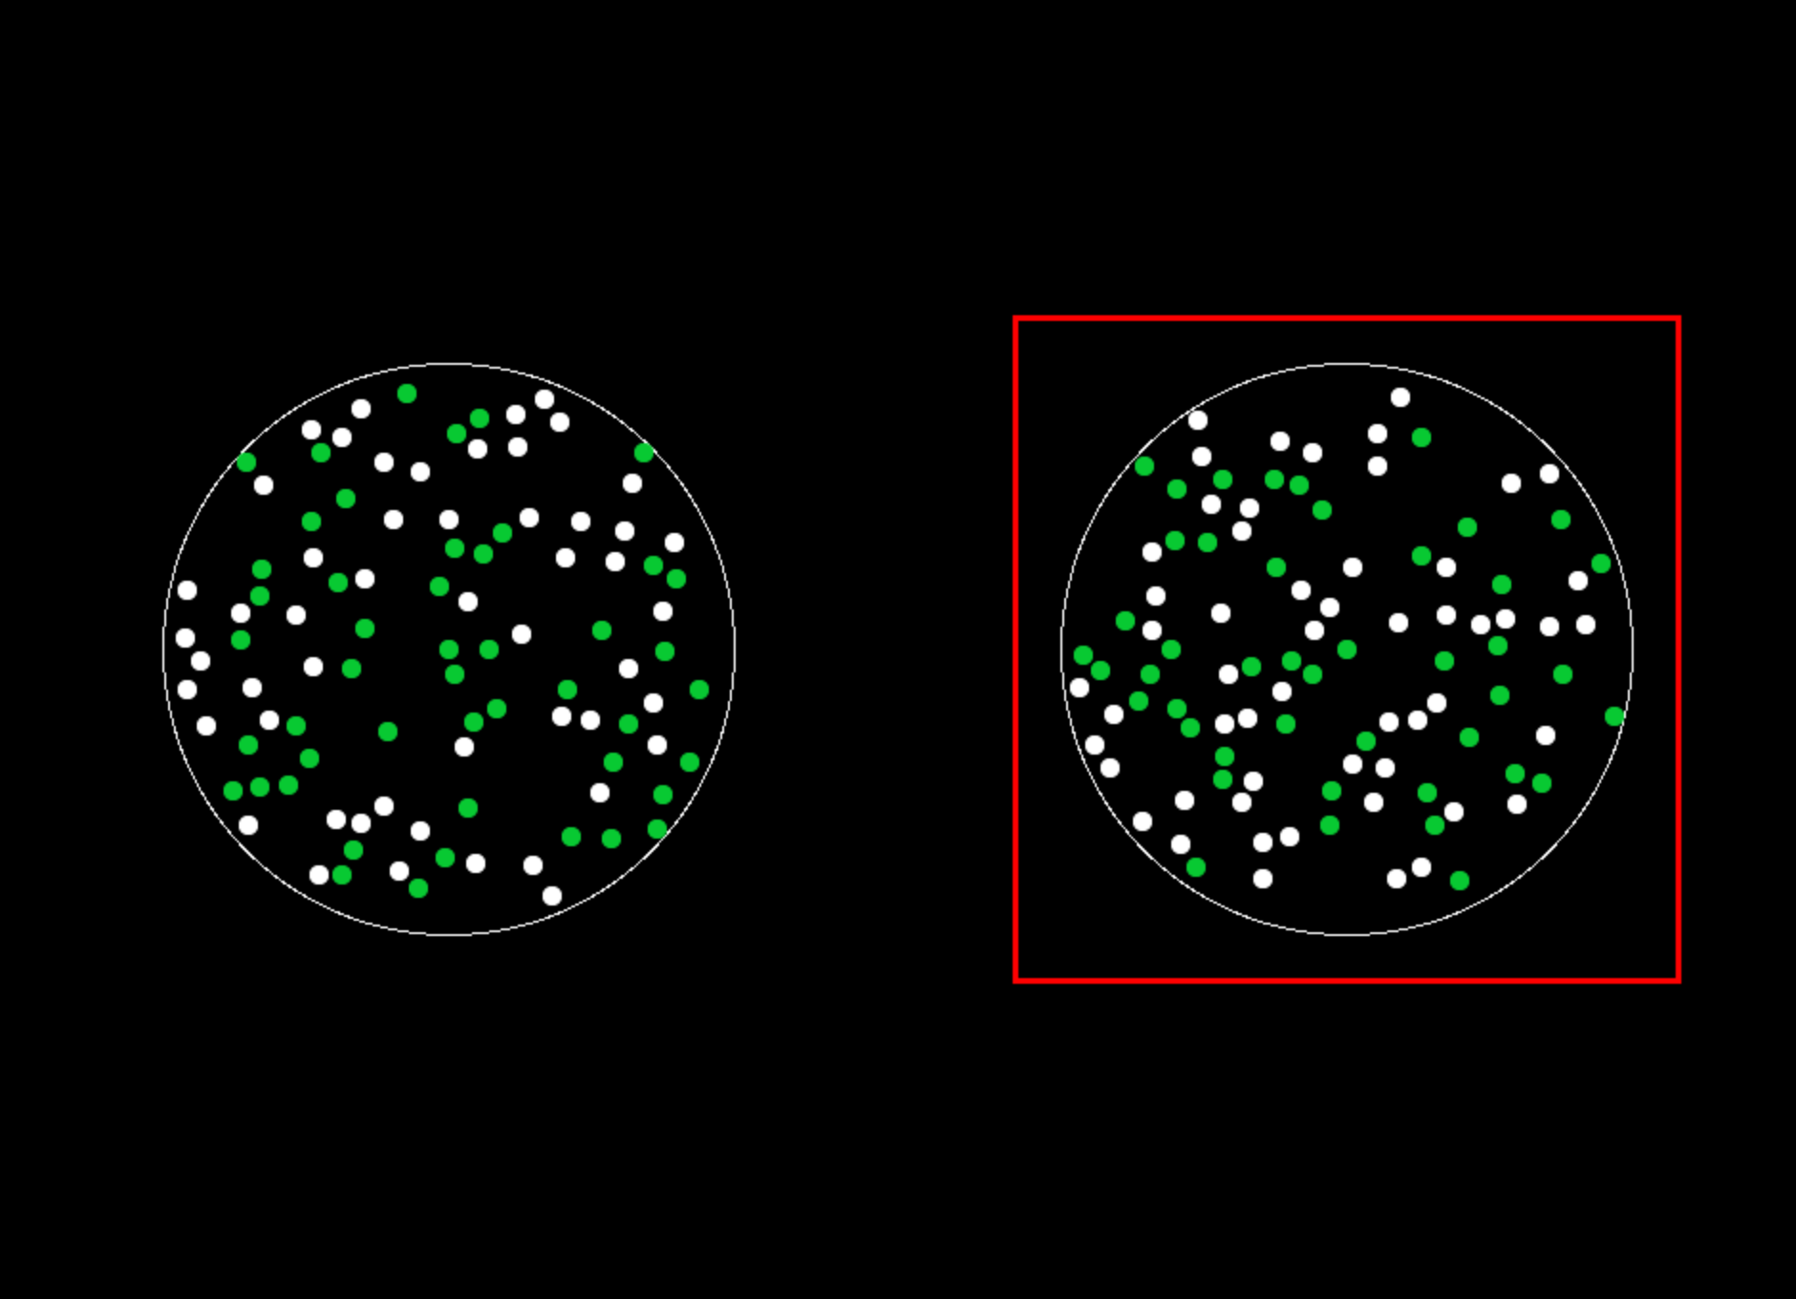

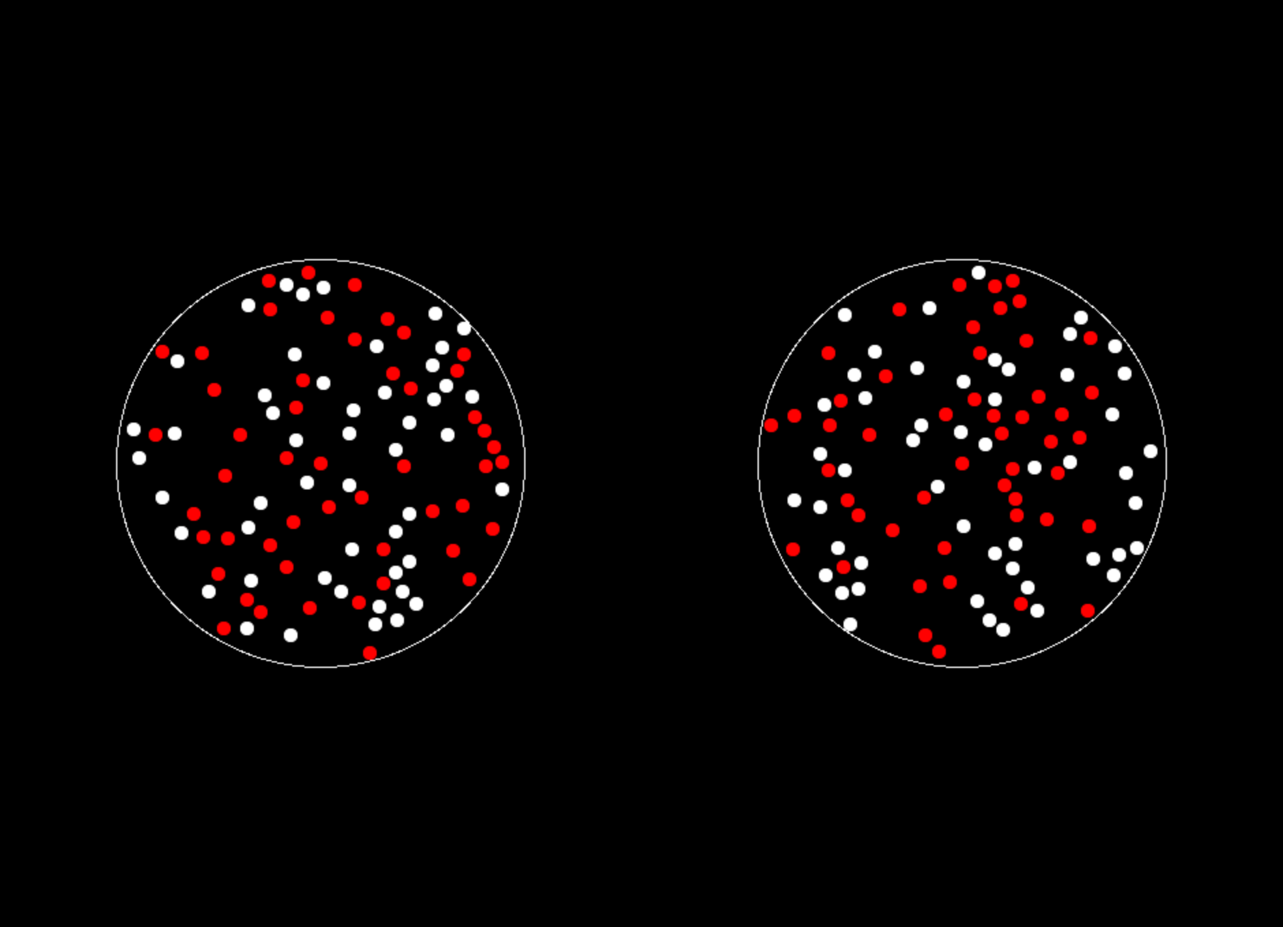
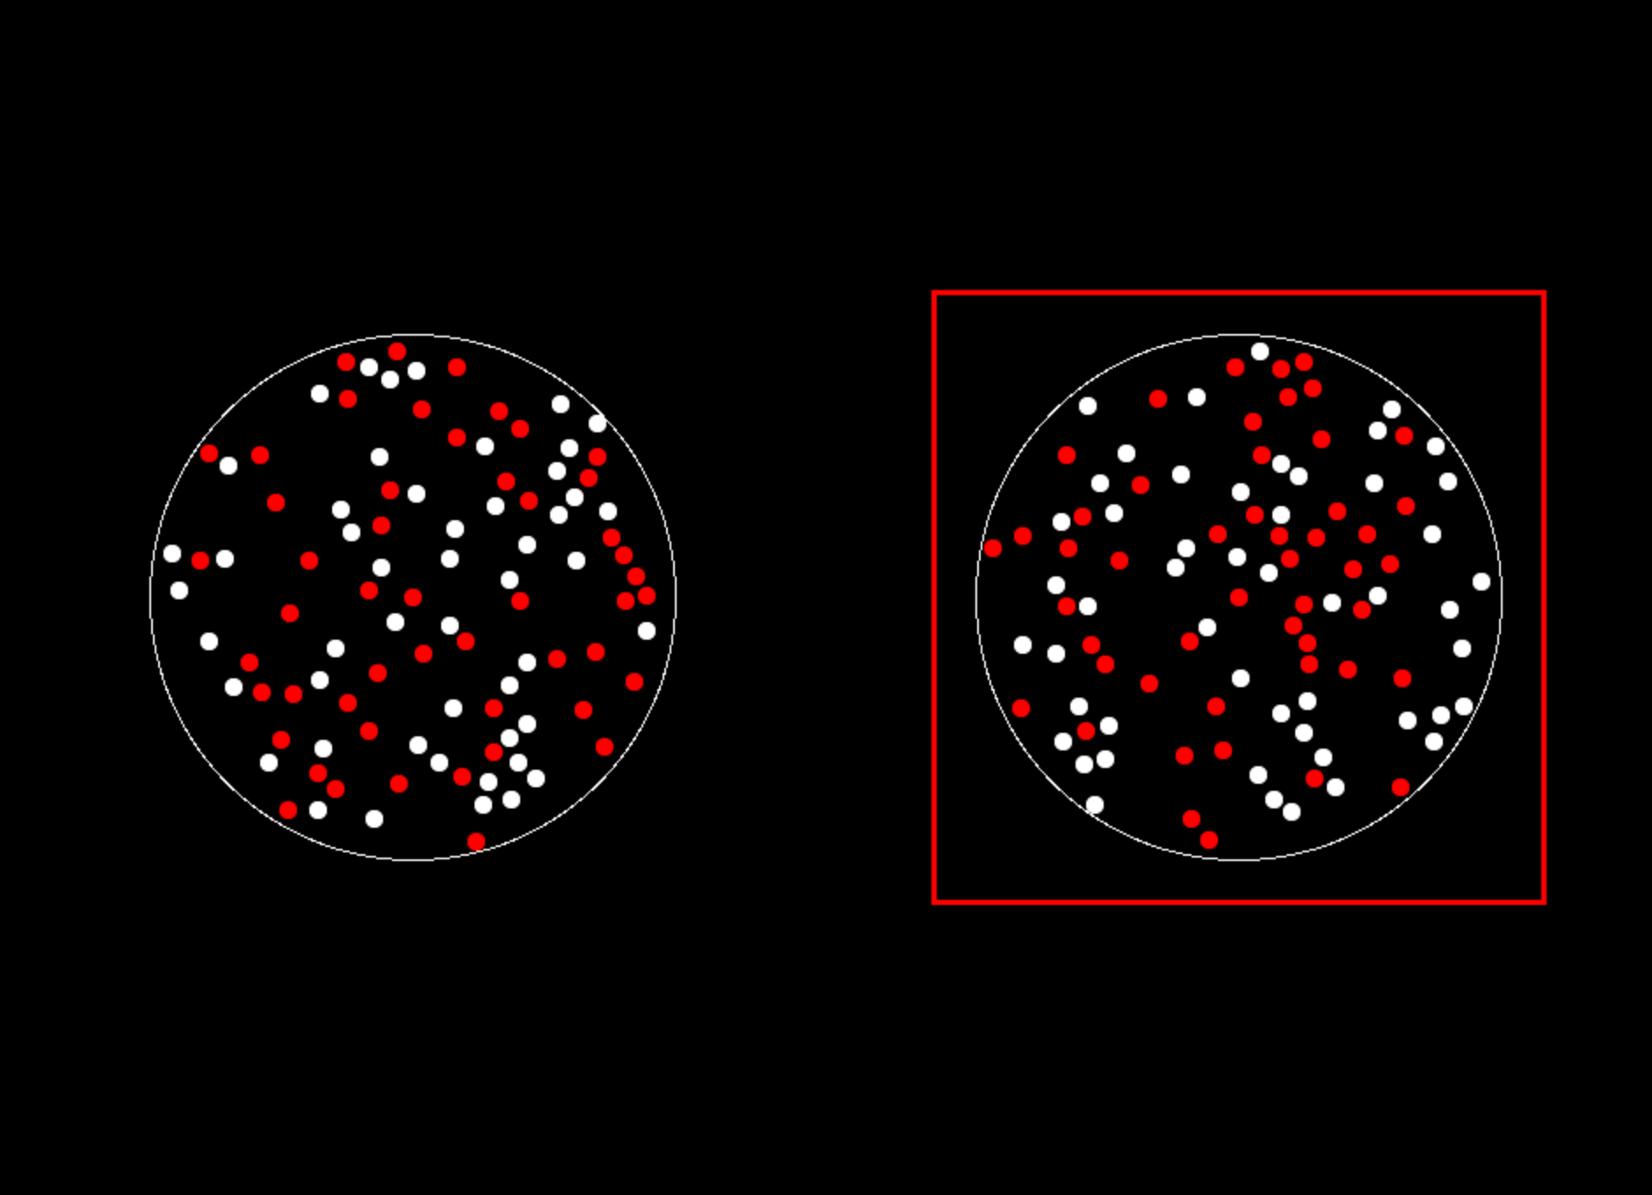
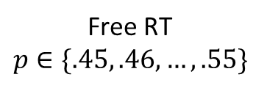
Study #1: “Dots”
N=35
400 trials
Gain
Loss
ITI
1 s
Free RT
$$p∈\{.45, .46, …, .55\}$$
Feedback
1 s
Eye-tracking

Slide 15
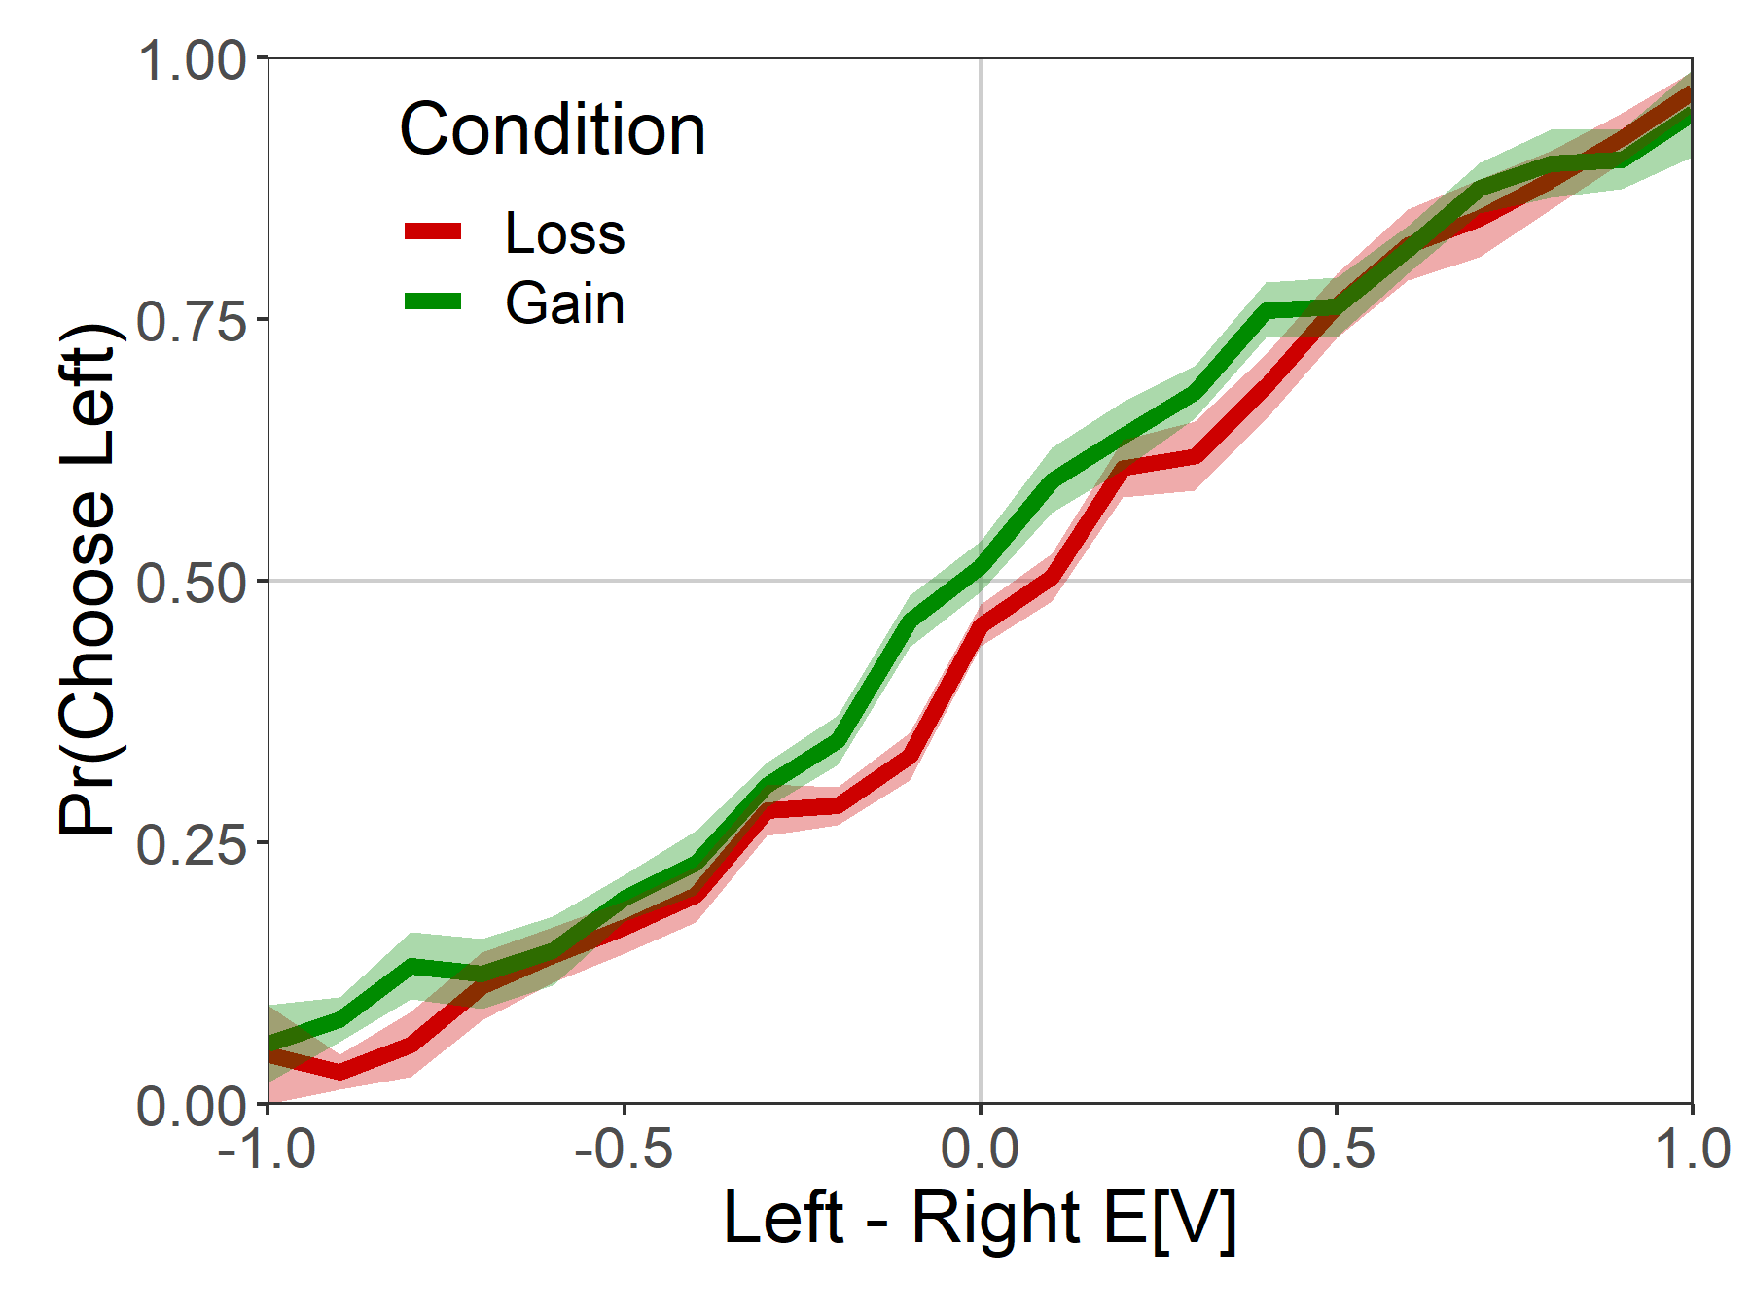
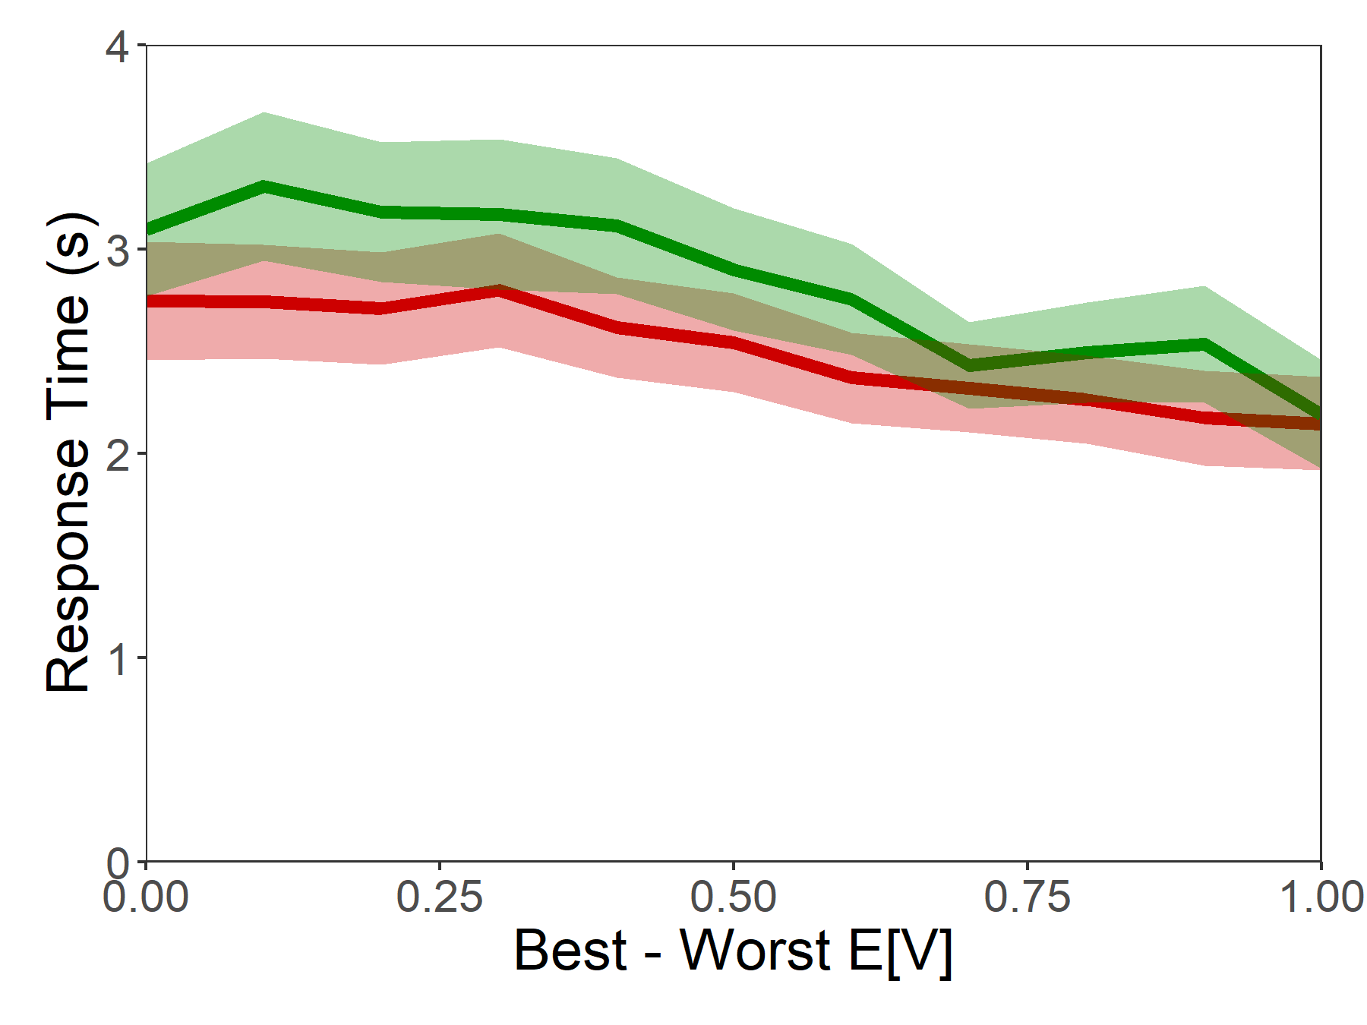
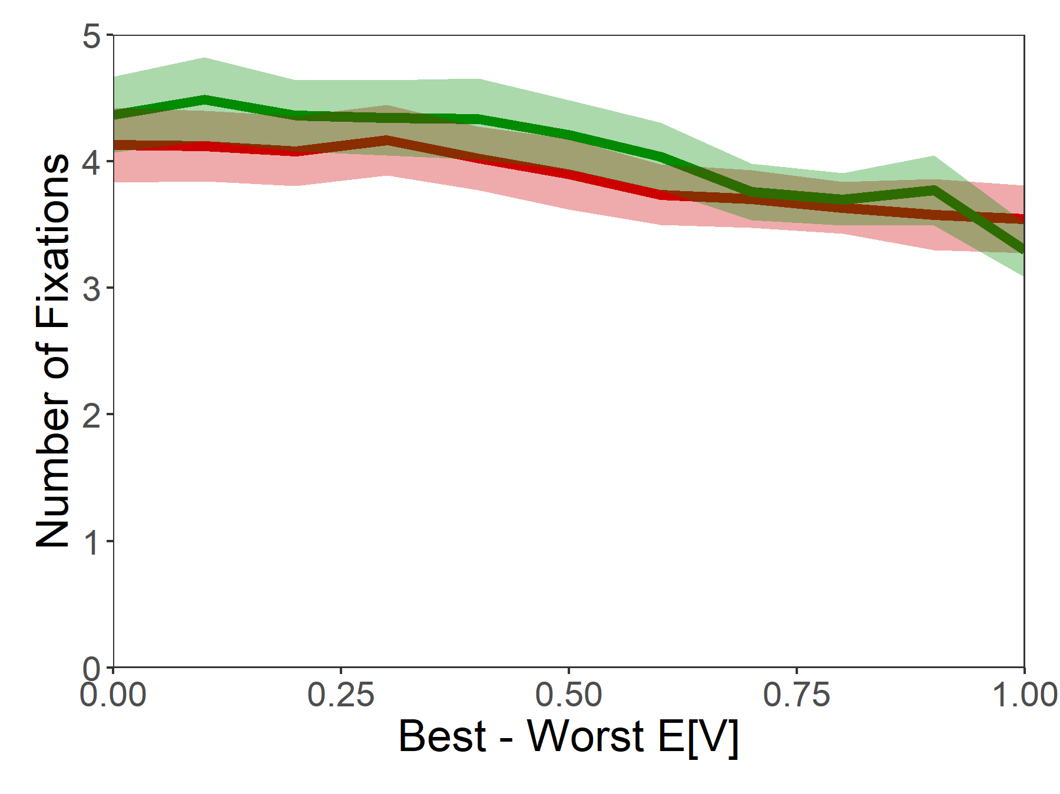
Basic Psychometrics

Slide 16
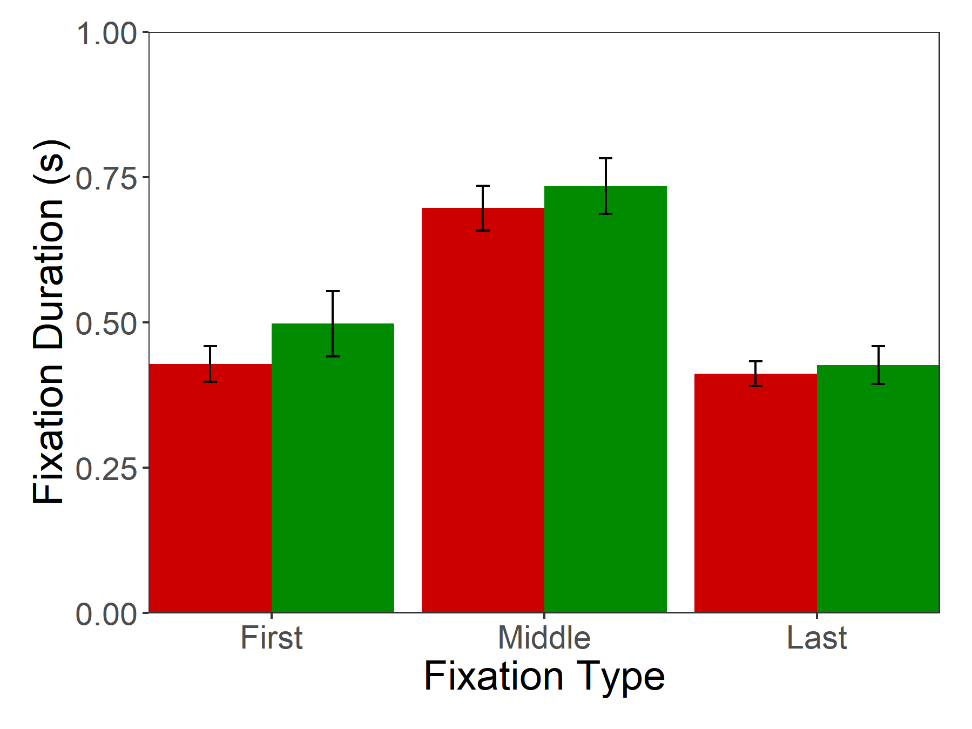
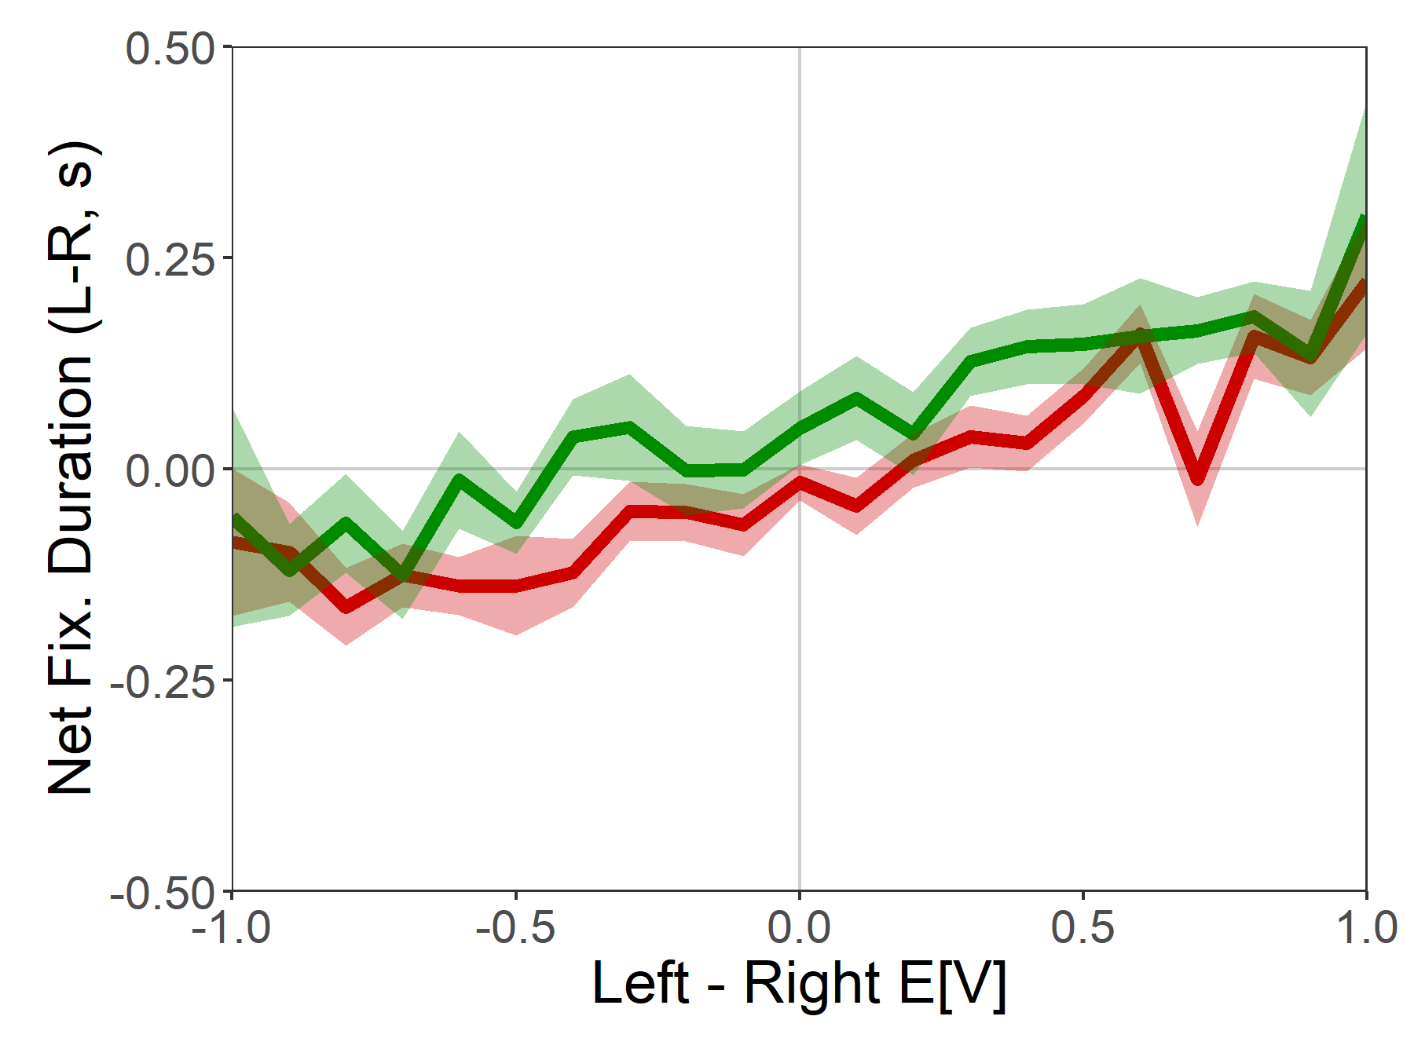
Fixation Properties

Slide 17
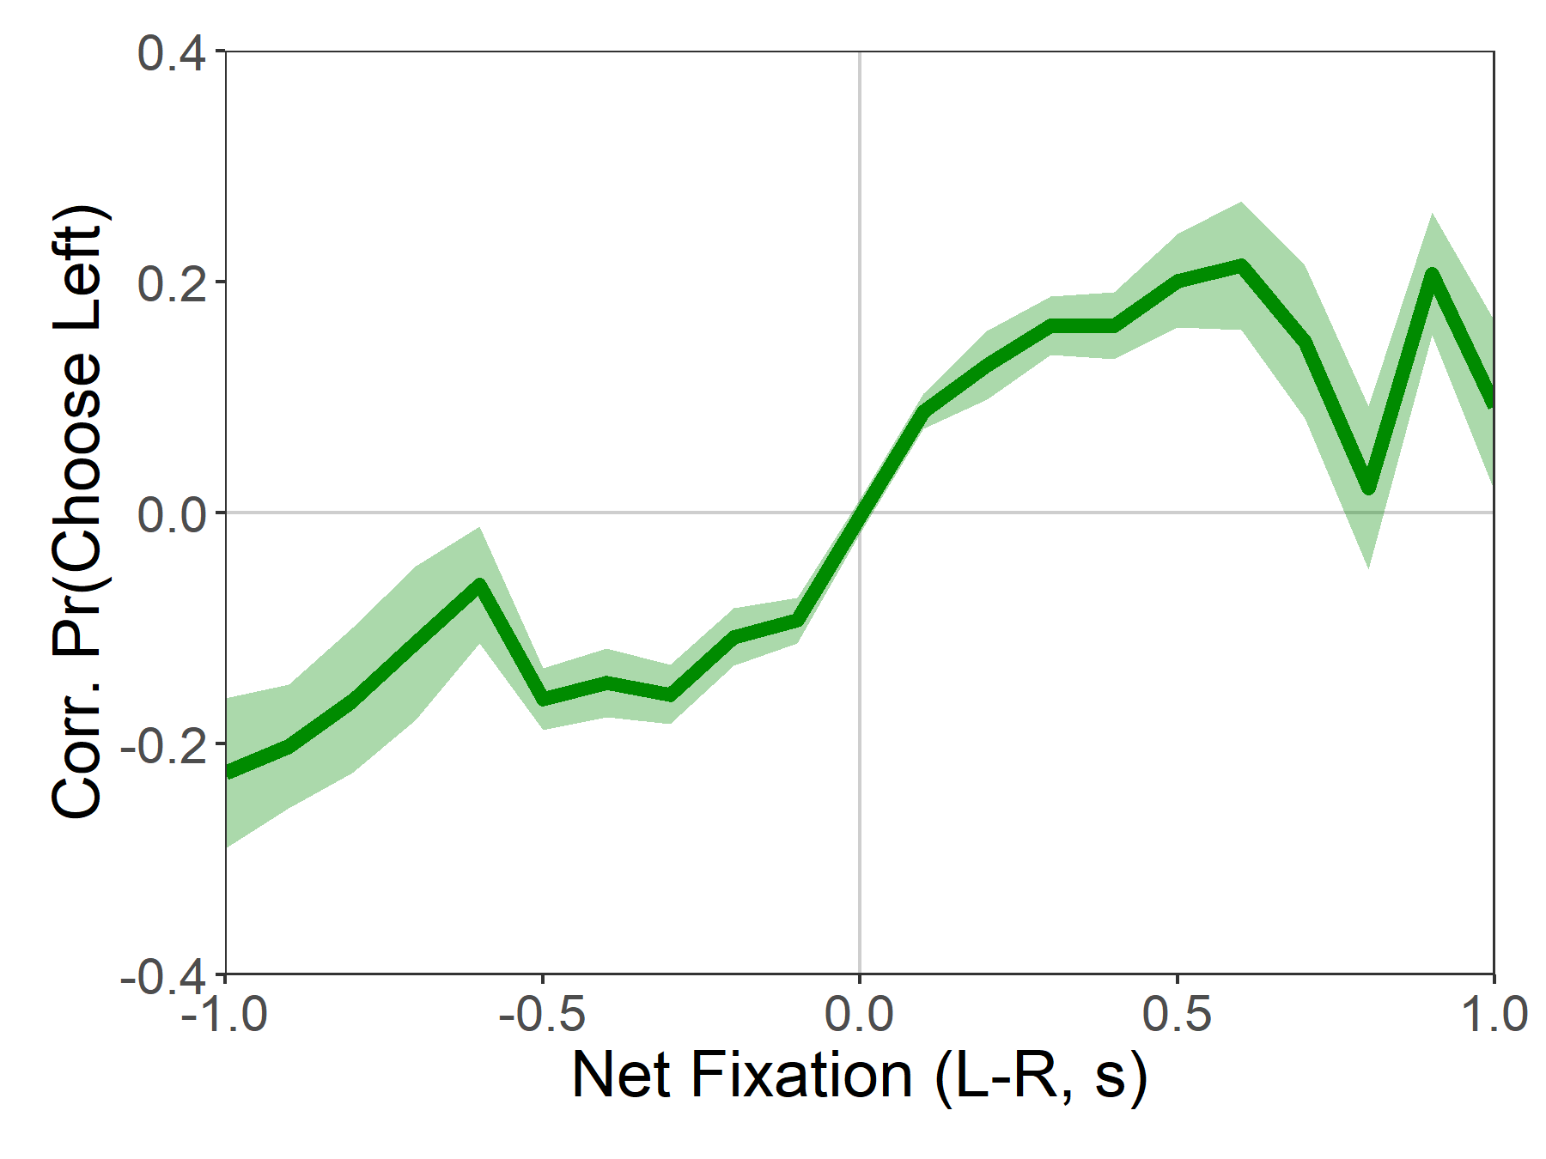
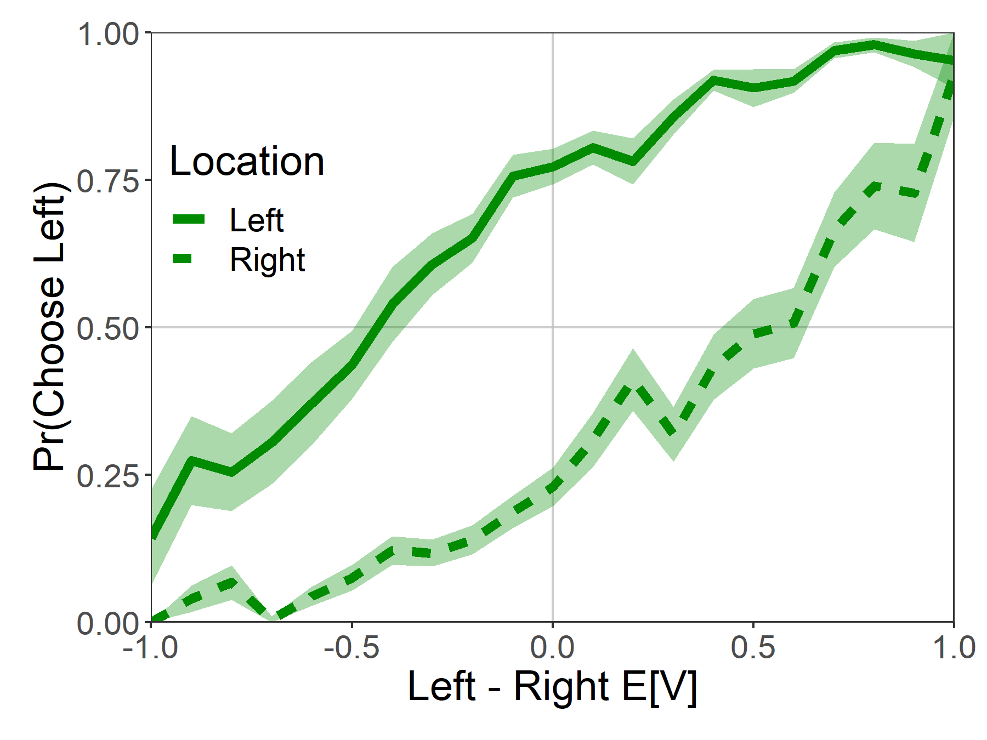
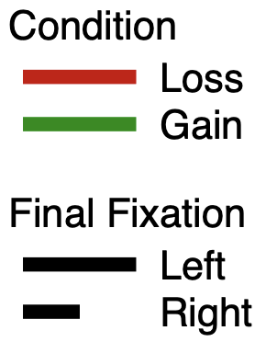
Attentional Choice Biases

Slide 18
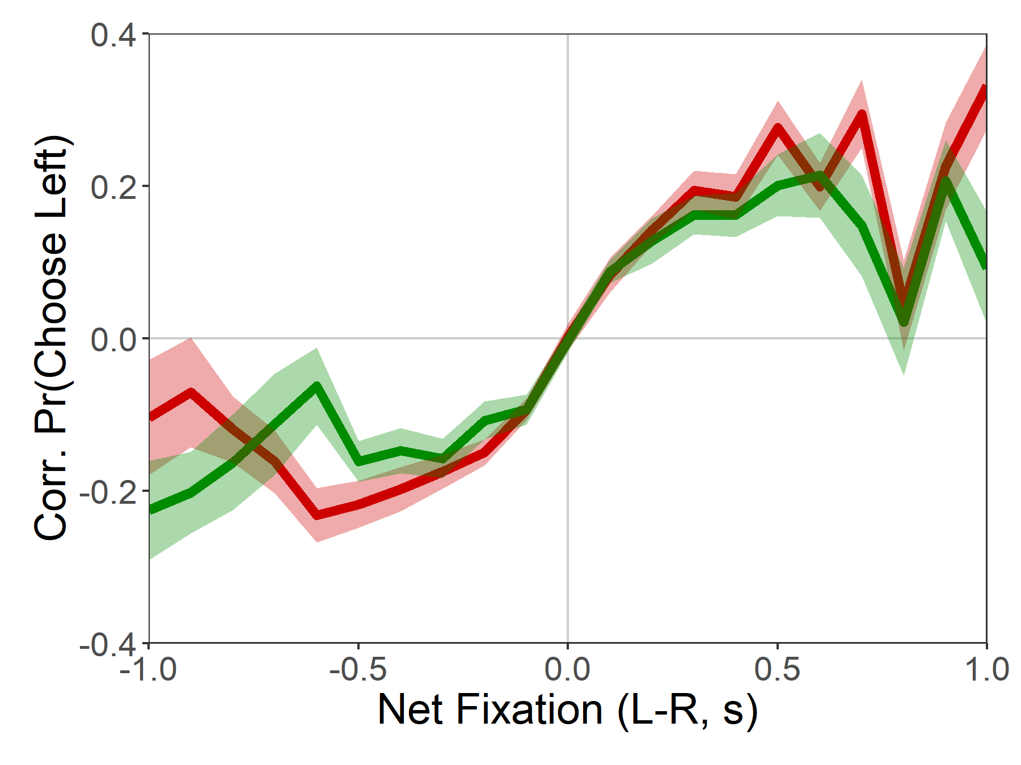
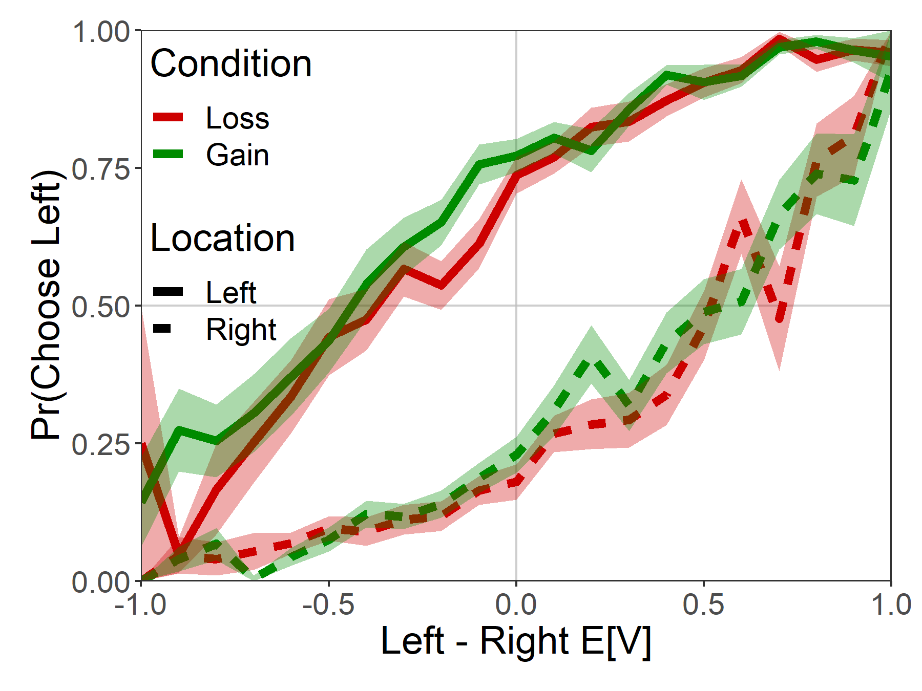
Attentional Choice Biases
Do NOT Flip!

Slide 19
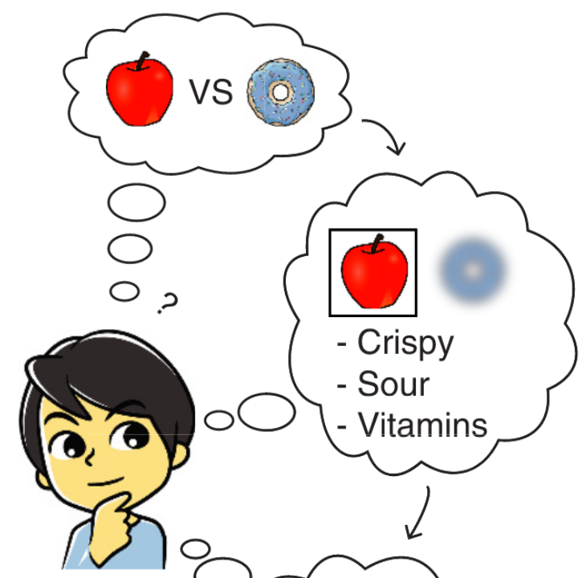
Count green
Count white
Thinking boy from Jang, Sharma, Drugowitsch (2021, eLife)
Brenden Eum

Slide 20
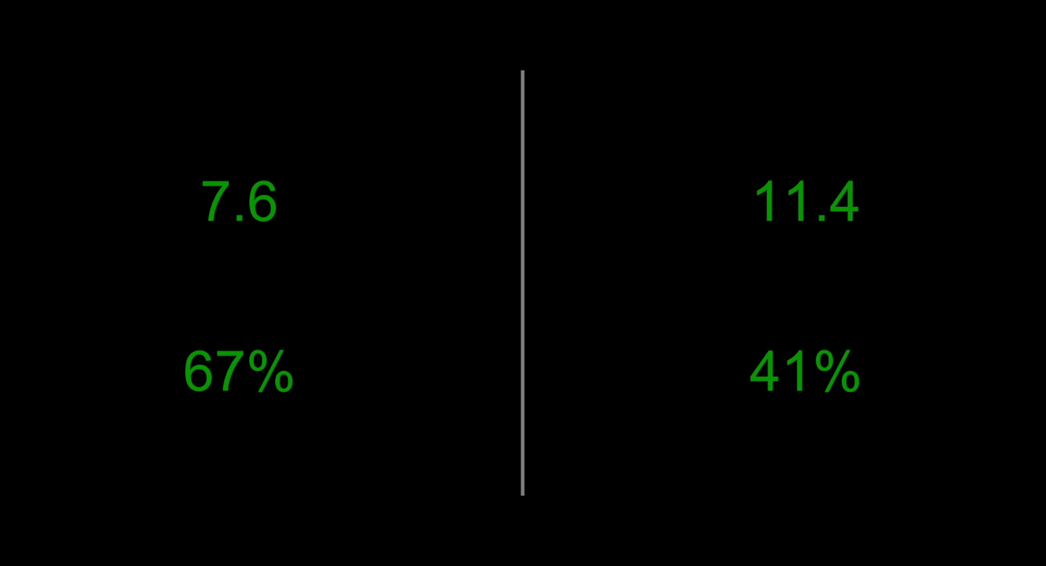
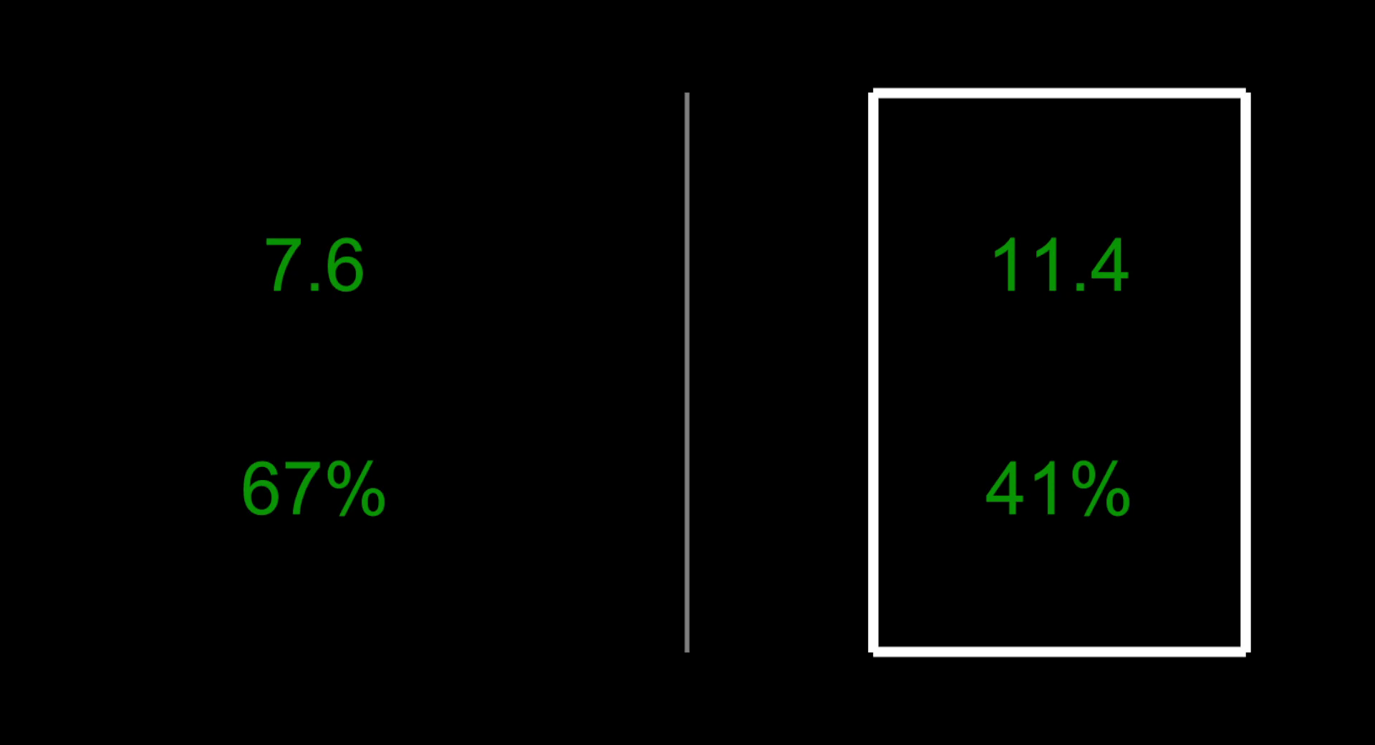
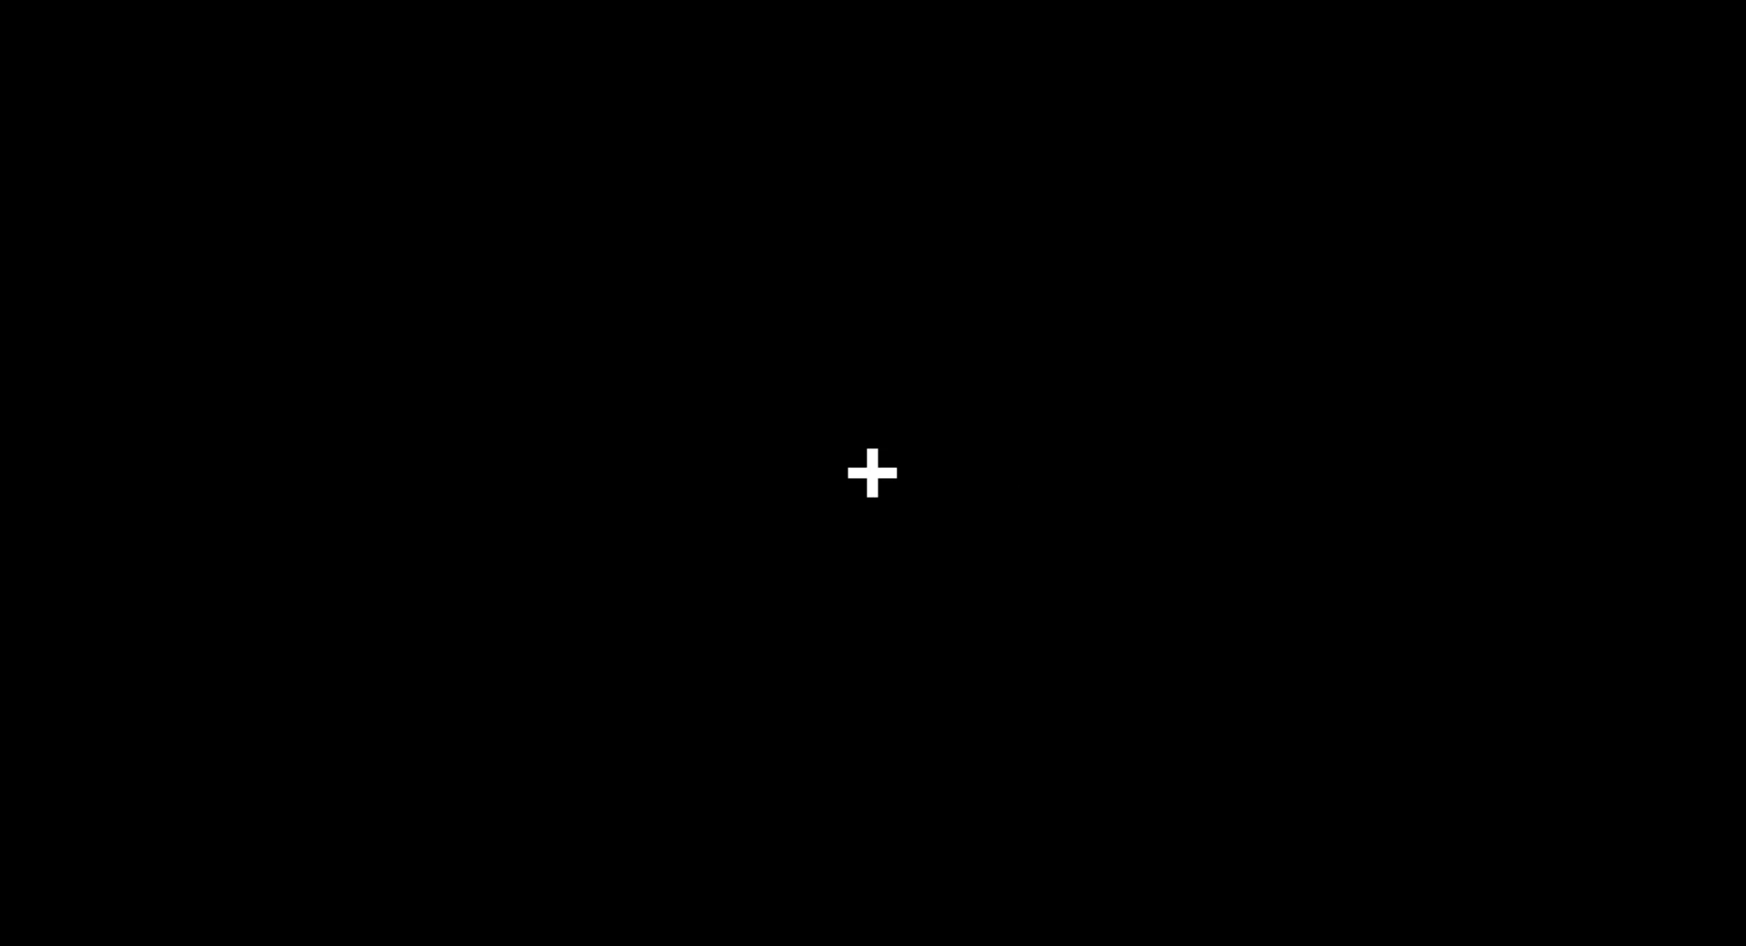
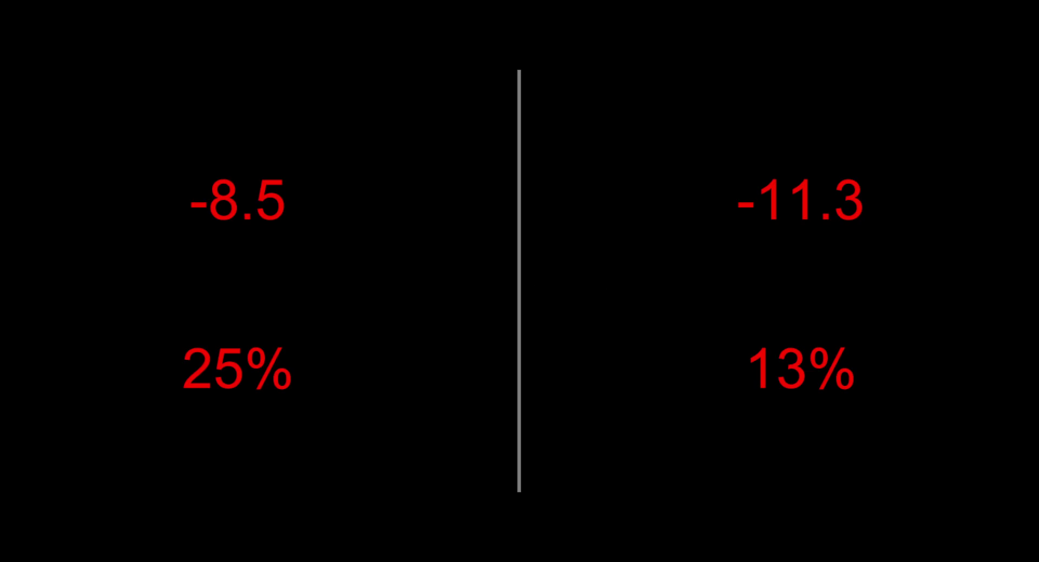
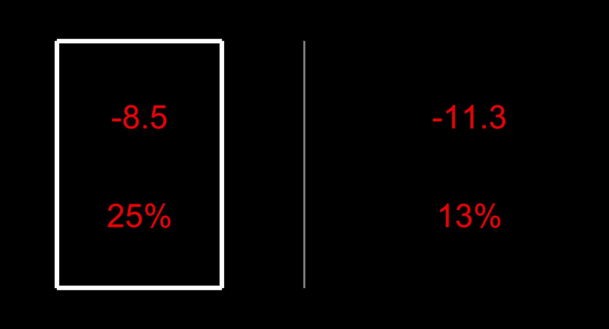
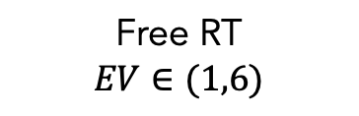
Study #2: “Numeric”
N=26
340 trials
Gain
Loss
ITI
1 s
Free RT
$$EV∈(1,6)$$
Feedback
1 s
Eye-tracking

Slide 21
Psychometrics

Slide 22
Fixation Properties

Slide 23
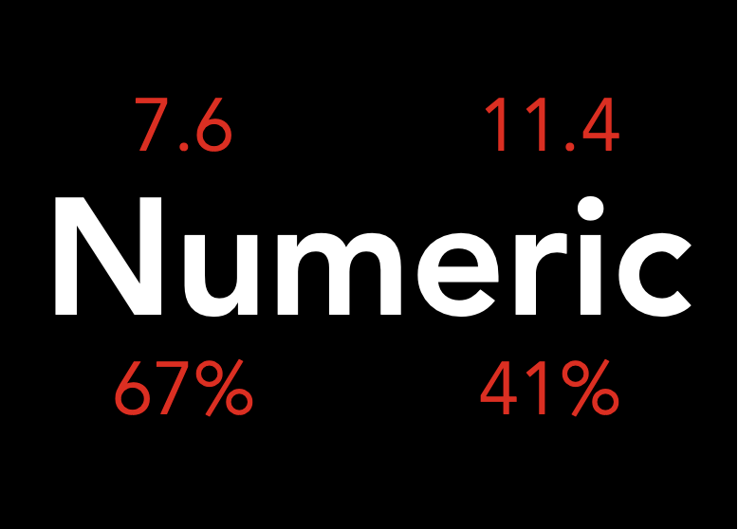

7.6
11.4
Numeric
Dots
67%
41%
Brenden Eum

Slide 24
Attentional Choice Biases
STILL Do Not Flip!

Slide 25
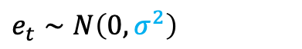
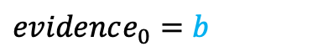


aDDM Parameter Estimates
*Each point is a single subject.
$evidence_{t}=evidence_{t−1}+μ_{t}+e_{t}$
Looking left: $μ_{t}=d(V_{L}−θV_{R})$
Looking right: $μ_{t}=d(θV_{L}−V_{R})$
$$e_{t}∼N\left(0, σ^{2}\right)$$
$evidence_{0}=b$
See Enkavi, Goldman, Yang, Rangel (in prep) for aDDM toolbox in Julia. It’s super fast!

Slide 26
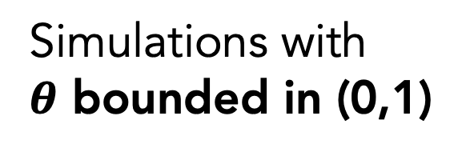
Observed Data
Simulations with
$θ$ bounded in (0,1)
Brenden Eum

Slide 27
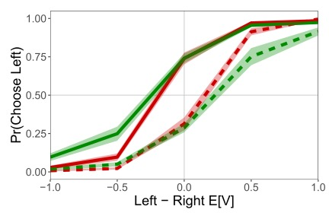
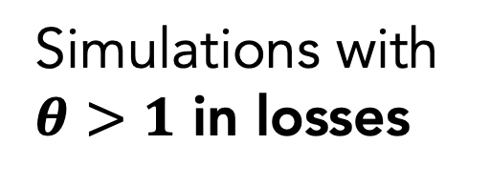
Observed Data
Simulations with
$θ>1$ in losses
Brenden Eum

Slide 28

Observed Data
PUZZLE:
What the heck does $θ>1$ intuitively mean?
Simulations with
$θ>1$ in losses
Brenden Eum

Slide 29
Intuition for $θ∈(0,1)$
V( ) = 3
V( ) = 4
See Jang, Sharma, Drugowitsch (2021, eLife); Callaway, Rangel, Griffiths (2021, PLoS Comput Bio)
Brenden Eum

Slide 30
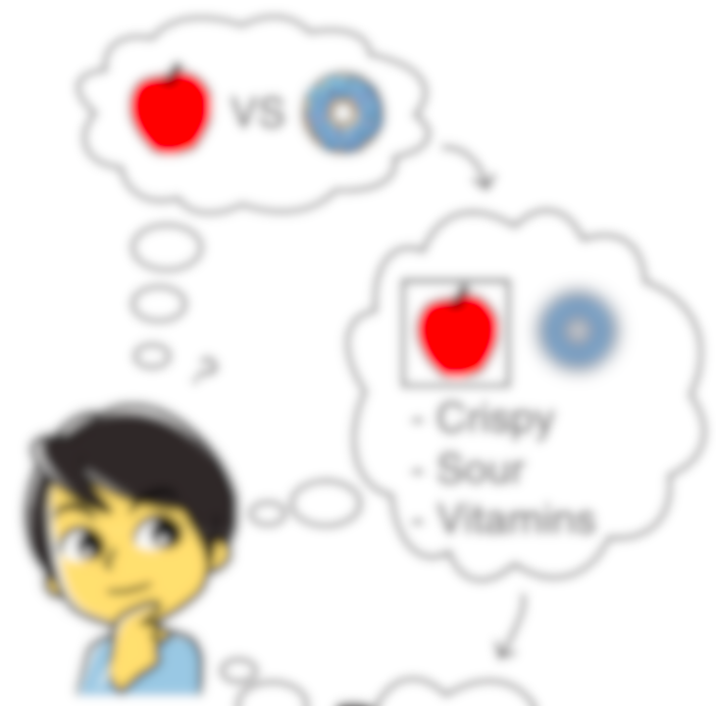

Intuition for $θ∈(0,1)$
V( )
Evidence
V( ) = 3
Time
V( ) = 4
V( )
See Jang, Sharma, Drugowitsch (2021, eLife); Callaway, Rangel, Griffiths (2021, PLoS Comput Bio)
Brenden Eum

Slide 31

Intuition for $θ∈(0,1)$
V( )
Evidence
V( ) = 3
Time
V( ) = 4
V( )
See Jang, Sharma, Drugowitsch (2021, eLife); Callaway, Rangel, Griffiths (2021, PLoS Comput Bio)
Brenden Eum

Slide 32
Intuition if $θ>1$
V( )
V( )
See Jang, Sharma, Drugowitsch (2021, eLife); Callaway, Rangel, Griffiths (2021, PLoS Comput Bio)
Brenden Eum

Slide 33
Intuition if $θ>1$
???
V( )
V( )
See Jang, Sharma, Drugowitsch (2021, eLife); Callaway, Rangel, Griffiths (2021, PLoS Comput Bio)
Brenden Eum

Slide 34
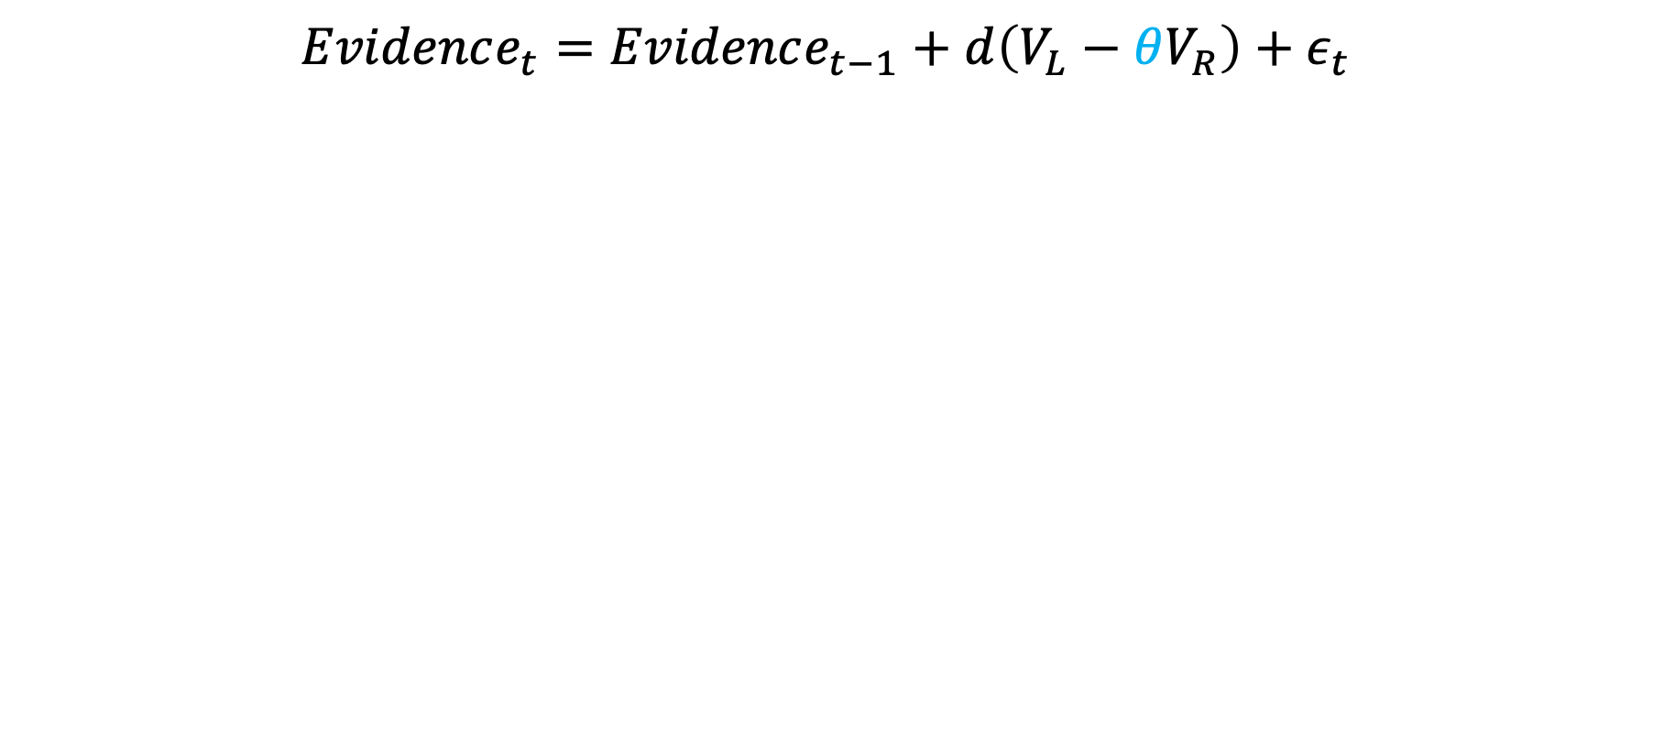
Potential Explanation
$$Evidence_{t}=Evidence_{t−1}+d\left(V_{L}−θV_{R}\right)+ε_{t}$$
Brenden Eum

Slide 35
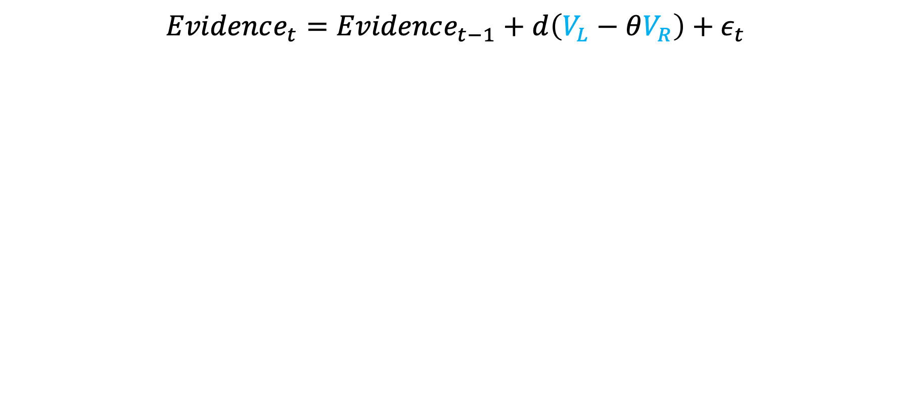
Potential Explanation
$$Evidence_{t}=Evidence_{t−1}+d\left(V_{L}−θV_{R}\right)+ε_{t}$$
Brenden Eum

Slide 36
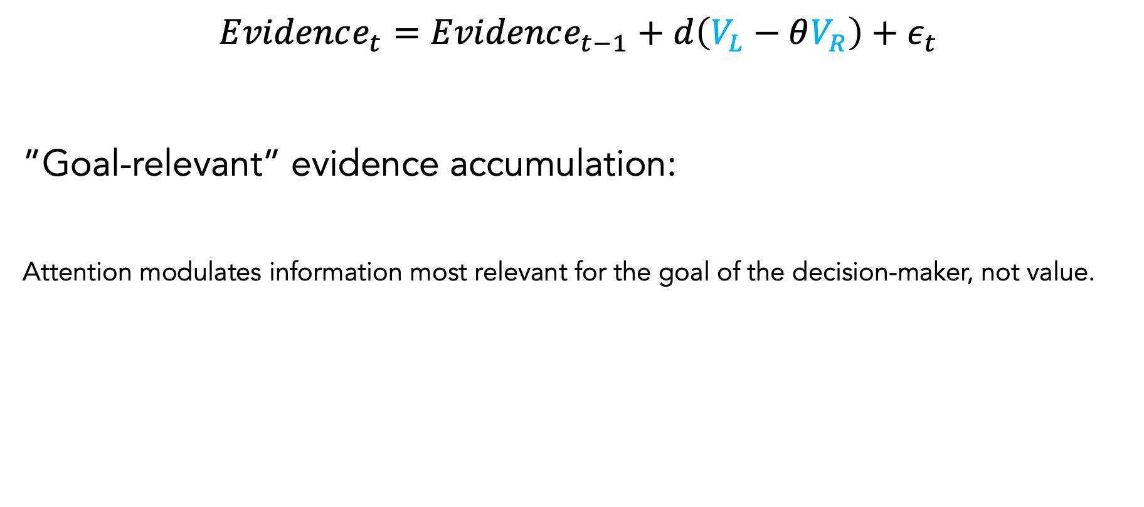
Potential Explanation
$$Evidence_{t}=Evidence_{t−1}+d\left(V_{L}−θV_{R}\right)+ε_{t}$$
”Goal-relevant” evidence accumulation:
Attention modulates information most relevant for the goal of the decision-maker, not value.
Sepulveda, Usher, Davies, Benson, Ortoleva, De Martino (2020, eLife)
Brenden Eum

Slide 37

Potential Explanation
$$Evidence_{t}=Evidence_{t−1}+d\left(V_{L}−θV_{R}\right)+ε_{t}$$
”Goal-relevant” evidence accumulation
Attention modulates information most relevant for the goal of the decision-maker, not value.
Sepulveda, Usher, Davies, Benson, Ortoleva, De Martino (2020, eLife)
Brenden Eum

Slide 38
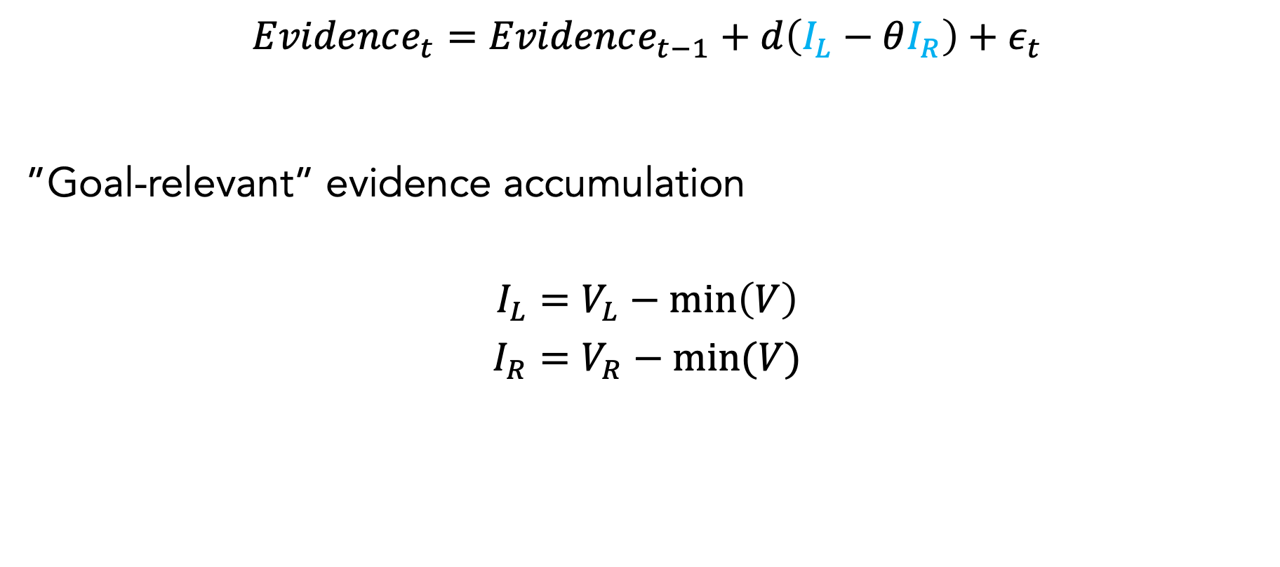
Potential Explanation
$$Evidence_{t}=Evidence_{t−1}+d\left(I_{L}−θI_{R}\right)+ε_{t}$$
”Goal-relevant” evidence accumulation
$$I_{L}=V_{L}−\min\left(V\right)$$
$$I_{R}=V_{R}−min⁡(V)$$
Sepulveda, Usher, Davies, Benson, Ortoleva, De Martino (2020, eLife)
Brenden Eum

Slide 39

Potential Explanation
$$Evidence_{t}=Evidence_{t−1}+d\left(I_{L}−θI_{R}\right)+ε_{t}$$
”Goal-relevant” evidence accumulation
$$I_{L}=V_{L}−\min\left(V\right)>0$$
$$I_{R}=V_{R}−\min\left(V\right)>0$$
If $I>0 ∀I$, then $θ∈(0,1)$.
Sepulveda, Usher, Davies, Benson, Ortoleva, De Martino (2020, eLife)
Brenden Eum

Slide 40

Are people always accumulating “goal-relevant” information in losses?
Free RT
Armel, Beaumel, and Rangel (2008, JDM)
Brenden Eum

Slide 41

Conclusion
Contrary to one of the assumptions of the aDDM, we find evidence of attentional amplification of the nonfixated option in choices between losses:
Attention to an option still pushes choice towards that option, even in losses.
The aDDM is capable of capturing these effects if we relax the boundaries on its attention parameter.
This leaves a puzzle about how attention may be affecting our decision process in choices between losses.
Brenden Eum

Slide 42


Brenden Eum

